Slide 1
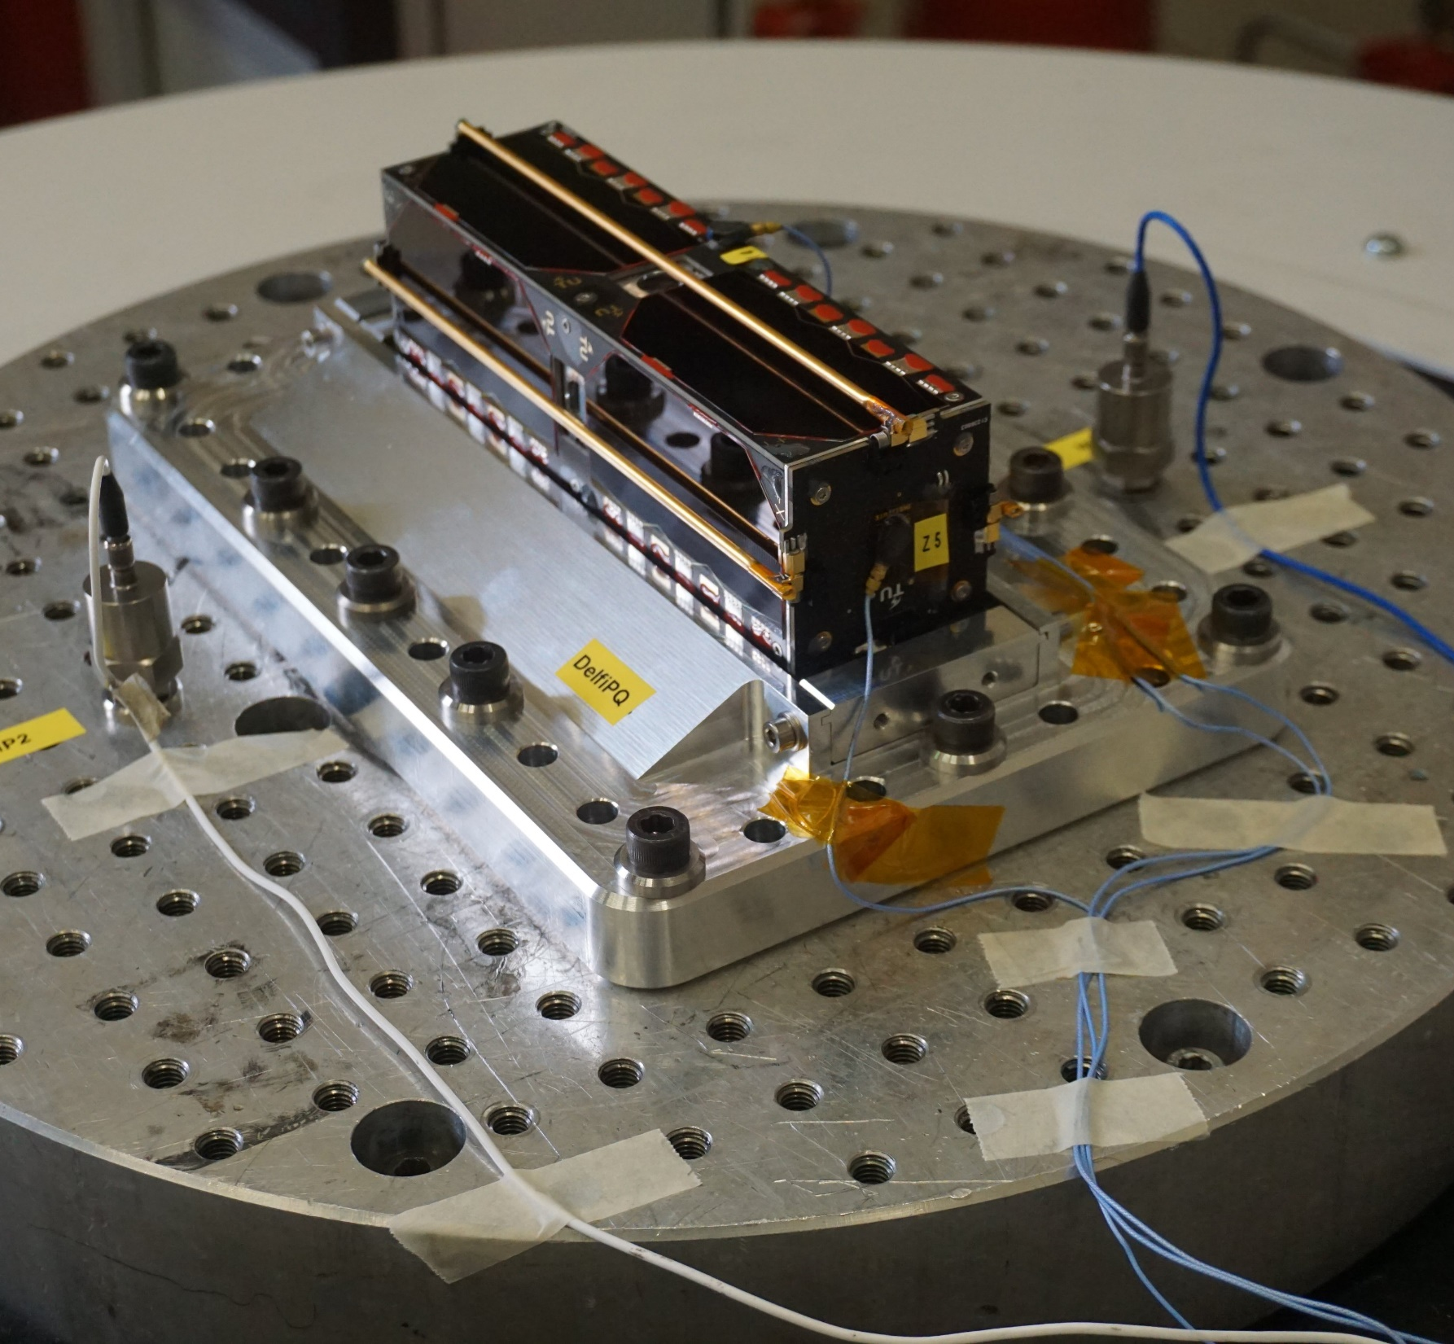
Use Reinforcement Learning to Generate Testing Commands for Onboard Software of Small Satellites
Zhuoheng Li
2022.11

Slide 2
Notice
This presentation is formular-free.
Chapter 4 in the thesis contains derivations.

Slide 3
Notice
Sorry…
200+ slides, but I only discuss a small part of it today.

Slide 4
Notice
Thesis and literature study documents available on Google Scholar with “onboard software testing” + “reinforcement learning” (the first result).
Slides and code are available on github.com/StarCycle
Full presentation has been uploaded to Youtube and Bilibili (under checking).

Slide 5
Content
Overview
Background
Method
Experiments
Conclusions & Recommendations

Slide 6
Content
Overview
Background
Method
Experiments
Conclusions & Recommendations
Interesting for the general space engineers

Slide 7
Content
Overview
Background
Method
Experiments
Conclusions & Recommendations

Slide 8
Overview
Main research question:
Can we use reinforcement learning (RL) to generate testing commands for small satellites with limited prior knowledge?

Slide 9
Overview
What I try (part 1):
3 RL algorithms (Q-Learning, D3QN, PPO)
3 state representations (scalar generated by rules, branch coverage vector, graph)
2 action spaces (Discrete, Multi-Discrete)
3 neural network architectures (MLP, GGNN, GAT) + different pooling mechanisms
2 ways to generate graph representation of source code (static analysis, dynamic analysis)
2 testing goals (maximize code coverage or CPU load)

Slide 10
Overview
What I try (part 2):
2 environments (a toy problem and the COMMS software)
2 testing senarios (normal testing and regression testing)
2 baselines (random testing and the genetic algorithm)
Generate testing commands on a local PC / cloud server
Implement open-source tool to retrieve branch coverage from embedded software
Other tools, like the command/response parser, state identification module, are developed in the study

Slide 11
Overview
Very brief answer:
Yes, RL-based testing performs better under some conditions compared with the two baselines

Slide 12
Content
Overview
Background
Method
Experiments
Conclusions & Recommendations

Slide 13
Content
Overview
Background
Method
Experiments
Conclusions & Recommendations

Slide 14
Background
About Delfi-PQ
Software Testing
Sequential Decision Making
RL-Based Testing

Slide 15
Background
About Delfi-PQ
Software Testing
Sequential Decision Making
RL-Based Testing
Interesting for the general space engineers

Slide 16
Background
About Delfi-PQ
Software Testing
Sequential Decision Making
RL-Based Testing

Slide 17
Background / About Delfi-PQ
Delfi-PQ is an open-source, low-cost, tiny satellite series.
Launch a PQ periodically so we always have a PQ in lab for students and researchers.

Slide 18
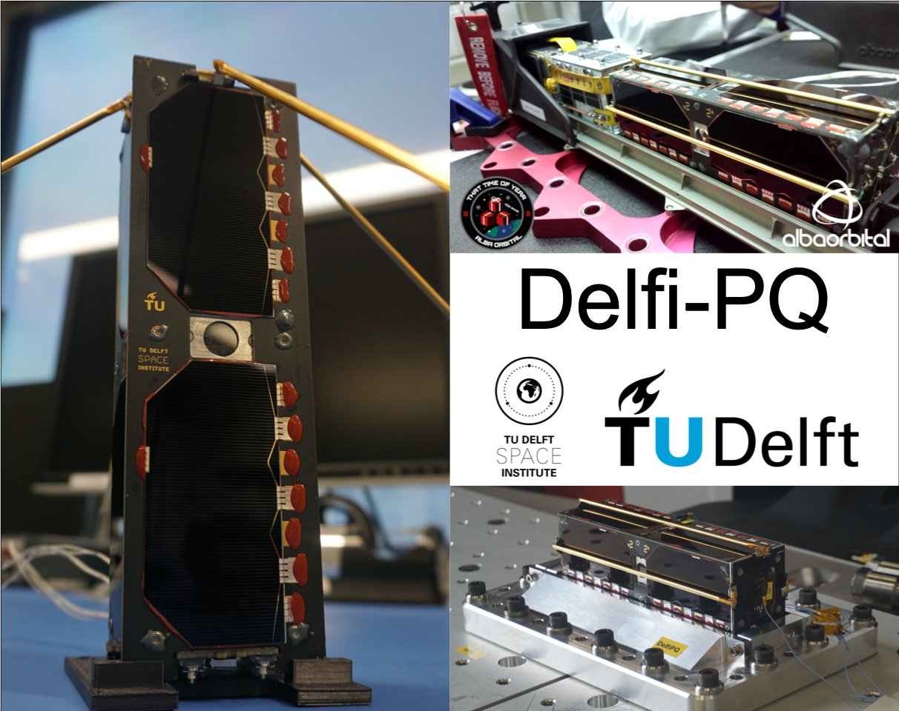
Background / About Delfi-PQ
First Delfi-PQ:
3P PocketQube
Size: 5*5*15cm
Weight: ~0.5kg
Power: average 1W
Downlink speed: 150Byte/s~1.2KB/s

Slide 19
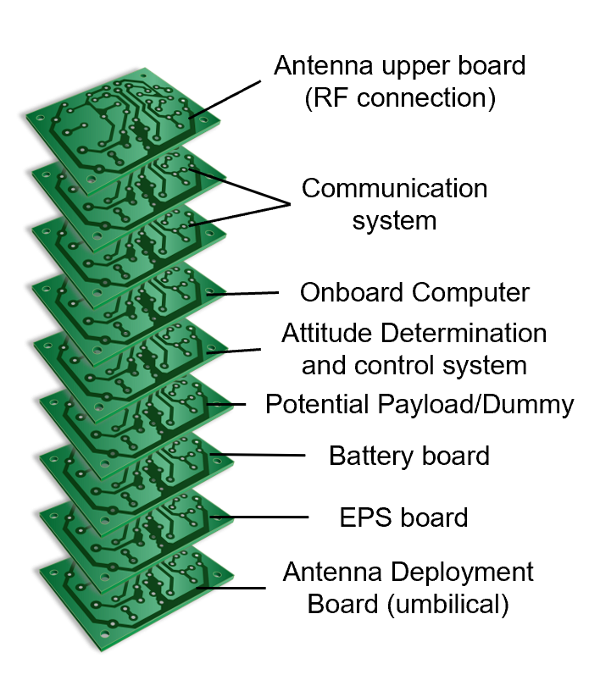
Background / About Delfi-PQ
Message Bus (managed by OBC)
Power Lines (managed by EPS)
Subsystems
OBC: On-Board Computer
EPS: Electrical Power System
COMMS: Communication System

Slide 20
Background / About Delfi-PQ
There are a microcontroller (MCU) and peripherals in each subsystem.
Software runs on the MCU to control the peripherals.

Slide 21
Background / About Delfi-PQ
Message Bus (managed by OBC)
Power Lines (managed by EPS)
Take COMMS as an example
OBC: On-Board Computer
EPS: Electrical Power System
COMMS: Communication System

Slide 22
Background / About Delfi-PQ
Communication system (COMMS)
Downlink antenna
Satellite Bus (UART)
Microcontroller
Transceiver
Receiver
Power amplifier
Low noise amplifier
Uplink antenna
Main Board
Daughter Board

Slide 23
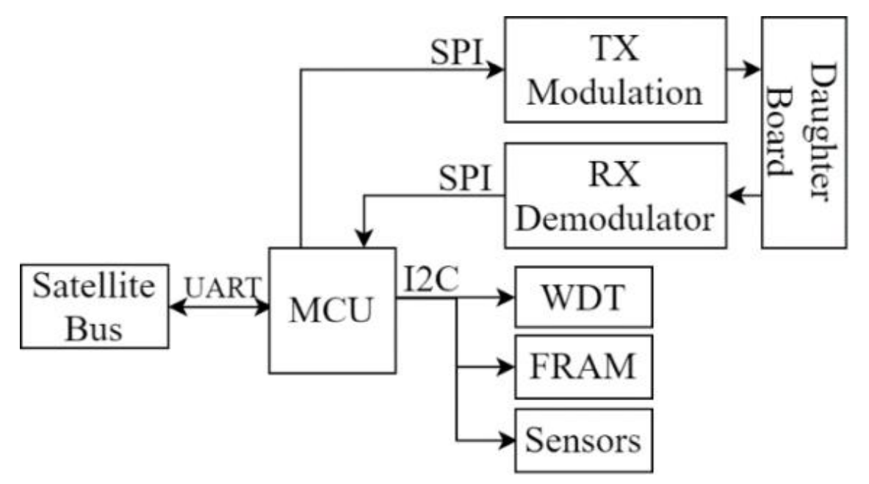
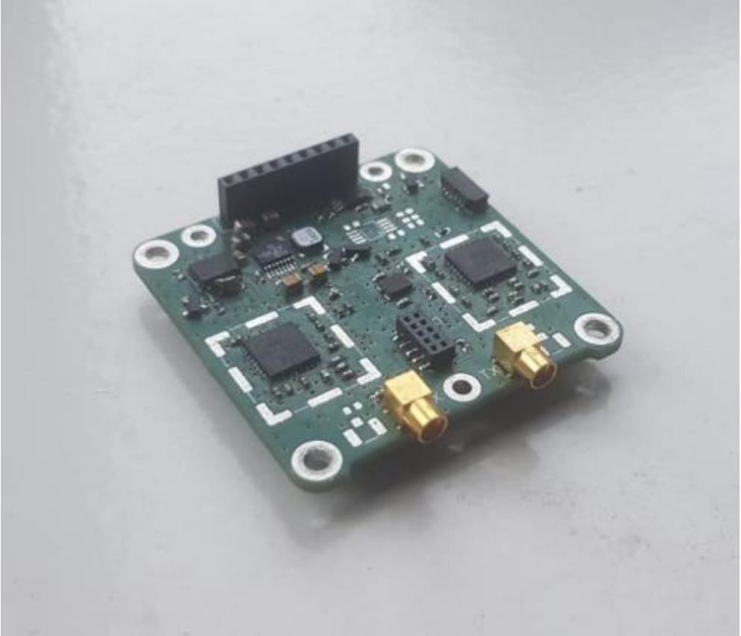
Background / About Delfi-PQ
COMMS Main Board
Watchdog
MSP432(ARM M4F)
Broekhuizen, C. H., Speretta, S., Uludag, M. S., van den Bos, M., Haenen, J., Menicucci, A., & Gill, E. (2020). Miniaturized Radio Tranceiver for PocketQubes, Exceeding Performance of CubeSat Solutions.

Slide 24
Background / About Delfi-PQ
Only the onboard computer (OBC) can send commands to subsystems.

Slide 25
Background / About Delfi-PQ
How are you?
(command to housekeeping service)
OBC
COMMS

Slide 26
Background / About Delfi-PQ
My bit rate is
1200 bps
(Reply of housekeeping service)
OBC
COMMS

Slide 27
Background / About Delfi-PQ
Set the rate to 9600 bps
(Command of radio service)
OBC
COMMS

Slide 28
Background / About Delfi-PQ
Yes, I have done that
(Reply of radio service)
OBC
COMMS

Slide 29
Background / About Delfi-PQ
COMMS receives telecommands from the ground station, put the telecommands in a buffer, and wait for OBC to fetch these telecommands

Slide 30
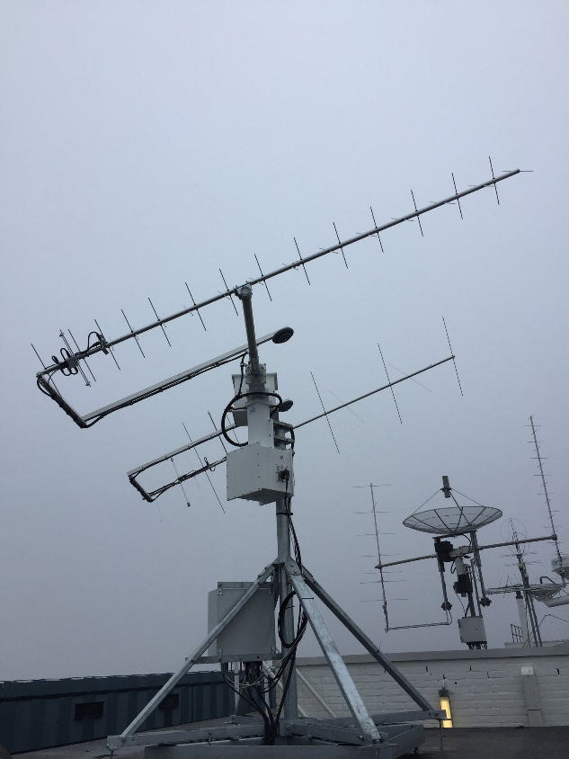
Background / About Delfi-PQ
Telecommand
OBC
COMMS
Ground Station

Slide 31
Background / About Delfi-PQ
Do you receive any ground command?
(Command of radio service)
OBC
COMMS
Ground Station

Slide 32
Background / About Delfi-PQ
Yes, I send it to you
(Reply of radio service)
OBC
Telecommand
COMMS
Ground Station

Slide 33
Background / About Delfi-PQ
EPS
Oh, it’s a command for EPS. EPS should …
OBC
COMMS
Ground Station

Slide 34
Background / About Delfi-PQ
OK
EPS
OBC
COMMS
Ground Station

Slide 35
Background / About Delfi-PQ
EPS has done that. COMMS should send the reply to the ground
OBC
COMMS
Reply of telecommand
Ground Station

Slide 36
Background / About Delfi-PQ
Yes, I send it to the ground station
OBC
COMMS
Reply of telecommand
Ground Station

Slide 37
Background / About Delfi-PQ
The command handler, as a special task, manages bus communication.
It has services to process received commands.

Slide 38
Background / About Delfi-PQ
Set the rate to 9600 bps
(Command of radio service)
OBC
COMMS

Slide 39
Background / About Delfi-PQ
Let radio service to process it
Radio task
Set the rate to 9600 bps
(Command of radio service)
Command handler
Task A
Task B
Radio service
Service
2
Service
…
Task …
Tasks of COMMS running on DelfiPQcore

Slide 40
Background / About Delfi-PQ
Radio task
Command handler
Task A
Task B
Radio service
Service
2
Service
…
Task …
Let radio task to do something
Tasks of COMMS running on DelfiPQcore

Slide 41
Background / About Delfi-PQ
Radio task
Command handler
Task A
Task B
Radio service
Service
2
Service
…
Task …
Get results from radio task
Tasks of COMMS running on DelfiPQcore

Slide 42
Background / About Delfi-PQ
Radio task
Command handler
Task A
Hello OBC, I finished it
Task B
Radio service
Service
2
Service
…
Task …
Tasks of COMMS running on DelfiPQcore

Slide 43
Background / About Delfi-PQ
The onboard software has different layers.

Slide 44
Background / About Delfi-PQ
Tasks
DelfiPQcore
Hardware driver libraries, provided by 3rd party (with our modifications)
Hardware abstraction layer

Slide 45
Background / About Delfi-PQ
Tasks
Real-time operation system (RTOS) made in house, because …
DelfiPQcore
Hardware abstraction layer

Slide 46
Background / About Delfi-PQ
Tasks are like applications on your phones.
Different subsystems have different tasks
Tasks
DelfiPQcore
Hardware abstraction layer

Slide 47
Background / About Delfi-PQ
Compare Delfi-PQ onboard software with other onboard software

Slide 48
Background / About Delfi-PQ
Onboard Software Repository | Number of Lines of Code | Language
Delfi-PQ Flight Software | 20107 | C, C++
NASA Core Flight System | 100132 | C, C++, Python, Perl
NASA JPL F Prime | 82915 | C, C++, Python
KubOS | 57968 | Rust, C, Python
ESA Nanosat-MO-Framework | 543396 | Java
Cal Poly libproc for CubeSat | 25649 | C, C++
FossaSat-1 Pocosatellite | 1534 | C++
EASAT-2 PocketQube | 1816 | C
MelbourneSpaceProgram | 21668 | C, C++
Simpler than software for “big” satellites

Slide 49
Background / About Delfi-PQ
Onboard Software Repository | Number of Lines of Code | Language
Delfi-PQ Flight Software | 20107 | C, C++
NASA Core Flight System | 100132 | C, C++, Python, Perl
NASA JPL F Prime | 82915 | C, C++, Python
KubOS | 57968 | Rust, C, Python
ESA Nanosat-MO-Framework | 543396 | Java
Cal Poly libproc for CubeSat | 25649 | C, C++
FossaSat-1 Pocosatellite | 1534 | C++
EASAT-2 PocketQube | 1816 | C
MelbourneSpaceProgram | 21668 | C, C++
Similar, or more complex than other CubeSat / PocketQube software

Slide 50
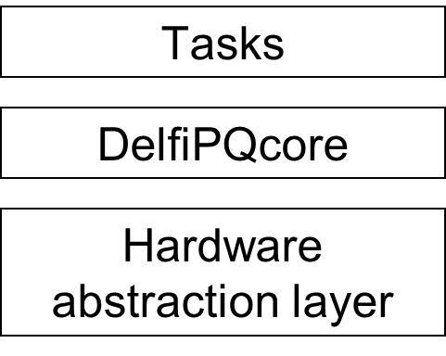
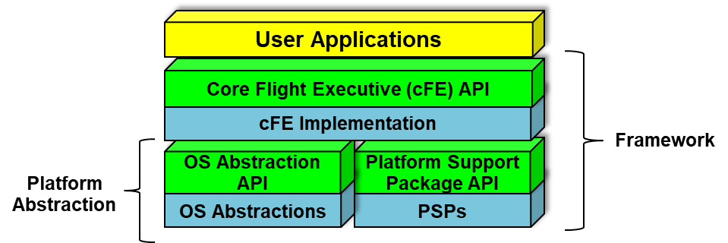
Background / About Delfi-PQ
Delfi-PQ onboard software
NASA core Flight System (cFS)
They also have different layers

Slide 51
Application in cFS | Explanation | Similar Functionality in Delfi-PQ
Health and Safety App | Kick watchdog, monitor applications and events, take table-defined actions | Kick watchdogs, but do not monitor tasks and take recovery actions
Housekeeping App | Collects and re-packages telemetry from other applications | Housekeeping service
Data Storage App | Record housekeeping, engineering. and science data onboard for downlink | OBC state machine does it
File Manager App | Interfaces to the ground for managing files | No
Limit Checker App | Compare the telemetry with thresholds and take table-defined actions | OBC state machine checks some telemetry parameters
Memory Dwell App | Sample data at any process address | No
Scheduler App | Schedule onboard applications | DelfiPQcore scheduler can do it
Stored Command App | Executes preloaded command sequences at predetermined time | No. Delfi-PQ execute all ground commands immediately
Software Bus Network | Passes Software Bus messages over various “plug-in” network protocols | No. Delfi-PQ has some dirty ways for inter-task communication, such as call back functions and global viriables
Checksum APP | Performs data integrity checking of memory, tables, and files | Delfi-PQ will check MD5 of binary code during software update, but it won’t check that in normal operation
Memory Manager App | Provides the ability to load and dump memory | No
CFDP App | Transfers/receives file data to/from the ground according to CCSDS CFDF protocol | The telemetry service can transfer telemetry data from the SD card to the ground station. It doesn’t follow the CFDF protocol
Command Ingest Lab | Accepts CCSDS telecommand packets over a UDP/IP port | OBC state machine and the radio service accept ground commands. It doesn’t follow the CCSDS standard
Telemetry Output Lab | Sends CCSDS telemetry packets over a UDP/IP port | OBC state machine and the radio service send telemetry to the ground. It doesn’t follow the CCSDS standard.
Delfi-PQ tasks have similar functions as the mission-independent Apps in NASA cFS

Slide 52
Application in cFS | Explanation | Similar Functionality in Delfi-PQ
Health and Safety App | Kick watchdog, monitor applications and events, take table-defined actions | Kick watchdogs, but do not monitor tasks and take recovery actions
Housekeeping App | Collects and re-packages telemetry from other applications | Housekeeping service
Data Storage App | Record housekeeping, engineering. and science data onboard for downlink | OBC state machine does it
File Manager App | Interfaces to the ground for managing files | No
Limit Checker App | Compare the telemetry with thresholds and take table-defined actions | OBC state machine checks some telemetry parameters
Memory Dwell App | Sample data at any process address | No
Scheduler App | Schedule onboard applications | DelfiPQcore scheduler can do it
Stored Command App | Executes preloaded command sequences at predetermined time | No. Delfi-PQ execute all ground commands immediately
Software Bus Network | Passes Software Bus messages over various “plug-in” network protocols | No. Delfi-PQ has some dirty ways for inter-task communication, such as call back functions and global viriables
Checksum APP | Performs data integrity checking of memory, tables, and files | Delfi-PQ will check MD5 of binary code during software update, but it won’t check that in normal operation
Memory Manager App | Provides the ability to load and dump memory | No
CFDP App | Transfers/receives file data to/from the ground according to CCSDS CFDF protocol | The telemetry service can transfer telemetry data from the SD card to the ground station. It doesn’t follow the CFDF protocol
Command Ingest Lab | Accepts CCSDS telecommand packets over a UDP/IP port | OBC state machine and the radio service accept ground commands. It doesn’t follow the CCSDS standard
Telemetry Output Lab | Sends CCSDS telemetry packets over a UDP/IP port | OBC state machine and the radio service send telemetry to the ground. It doesn’t follow the CCSDS standard.
But,
- Mission-dependent Apps in cFS are more complex
- We do not follow some standards, e.g., CCSDS CFDF

Slide 53
Background / About Delfi-PQ
In the DelfiPQcore level:
DelfiPQcore provides similar capabilities to core Flight Executive (cFE) of cFS.
But it does NOT have a formal inter-task communication interface.
It also does NOT have complex fault-handling mechanism.

Slide 54
Background / About Delfi-PQ
Delfi-PQ was launched in January 2022.
It is working now.

Slide 55

Background / About Delfi-PQ
Cape Canaveral

Slide 56
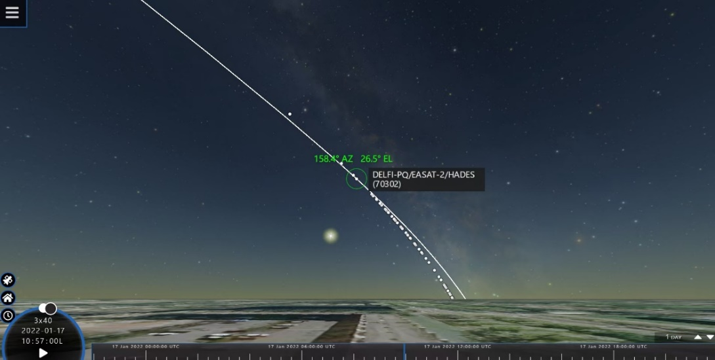
Background / About Delfi-PQ
After launch

Slide 57
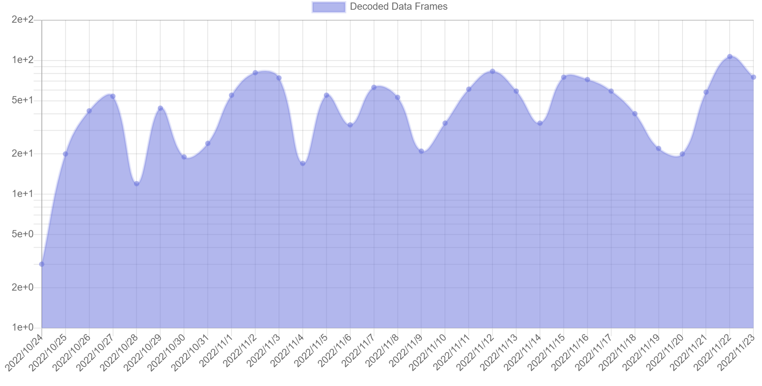
Background
Telemetry in past 30 days

Slide 58
Background / About Delfi-PQ
There were problems due to lack of testing…but we are lucky!
(More stories in the thesis document)

Slide 59
Background
About Delfi-PQ
Software Testing
Sequential Decision Making
RL-Based Testing

Slide 60
Background
About Delfi-PQ
Software Testing
Sequential Decision Making
Reinforcement Learning

Slide 61
Background / Software Testing
Definitions
Test case is a pre-written sequence of testing commands which will be executed during a test.
By contrast, test command generation selects commands in real time, according to the current state (my study).
Test oracle is a set of conditions to determine whether the system under test behaves correctly or not.
Test coverage is a metric that shows the amount of testing performed. Different coverage types: code coverage (line, branch, MC/DC...), state coverage, requirement coverage, etc.

Slide 62
Background / Software Testing
Definitions
Testing goals are immediate goals that help testers find bugs.
Examples include:
Maximize specific test coverage (code/state/requirement coverage)
Maximize a computable metric (CPU load, estimated risk, etc)

Slide 63
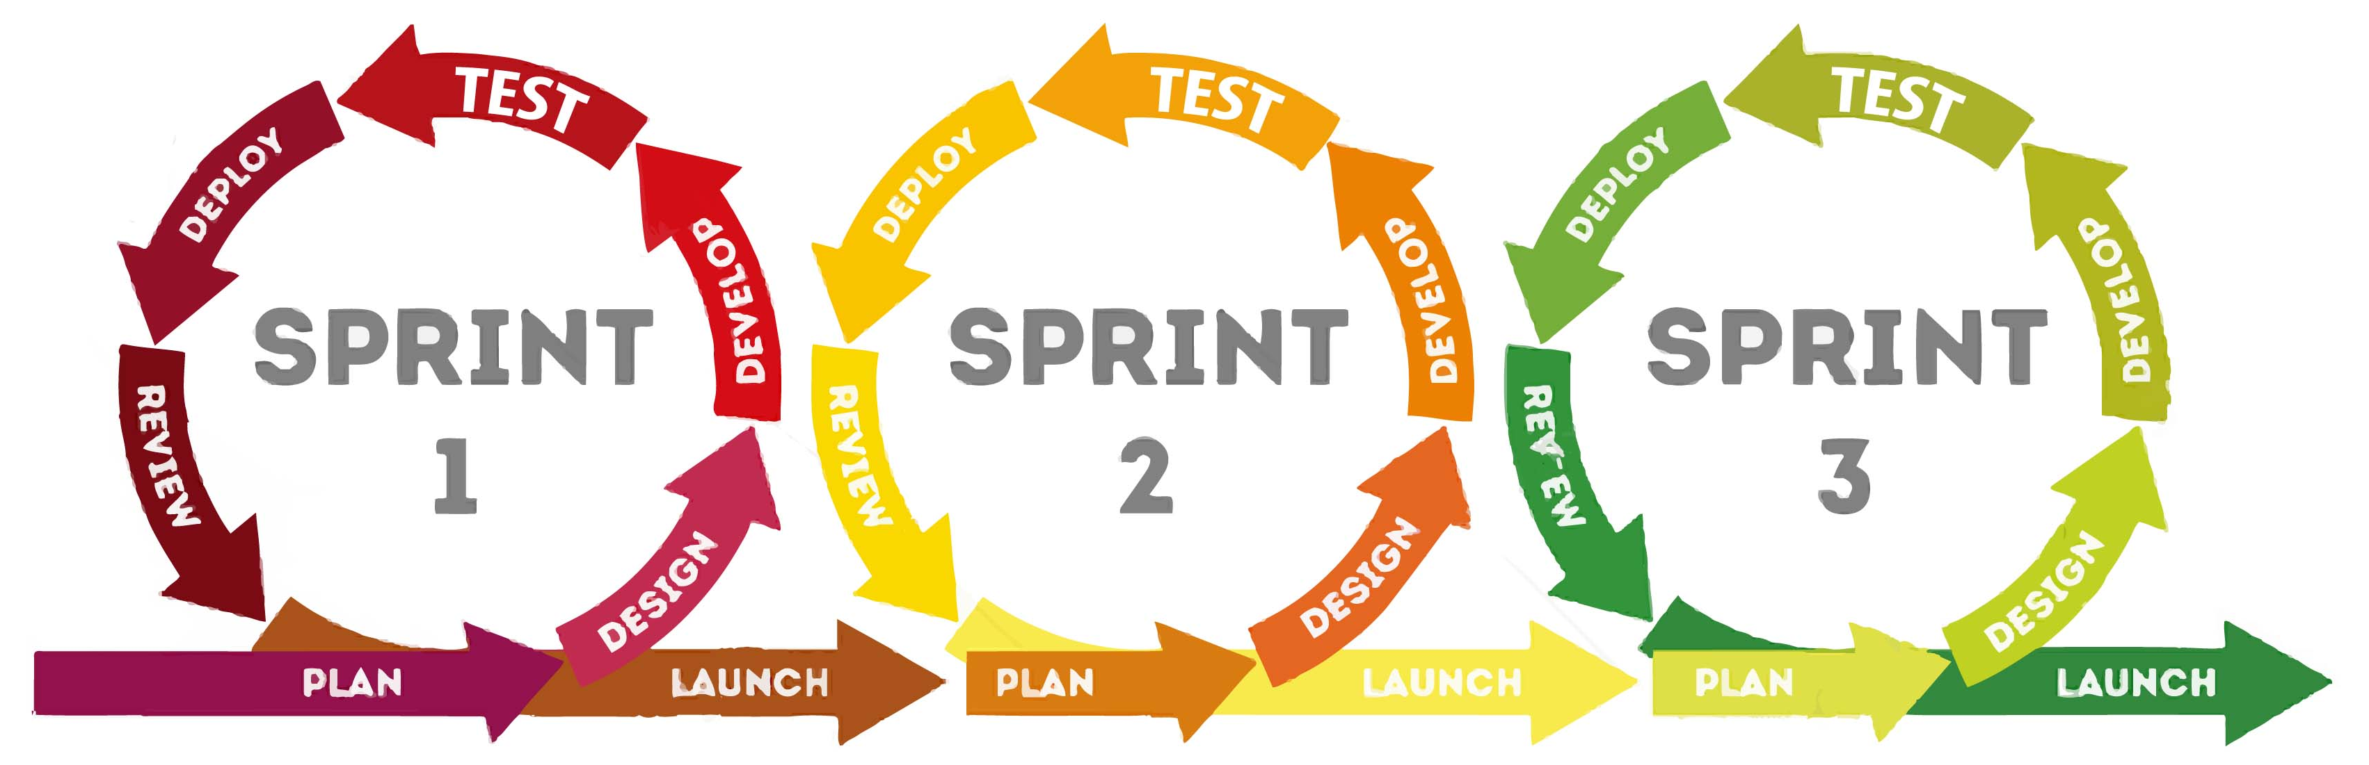
Background / Software Testing
Definitions
Regression testing tries to confirm a recent code change has not affected existing features.

Slide 64
Background / Software Testing
Write test cases manually takes too much human effort and prior knowledge from experts.

Slide 65
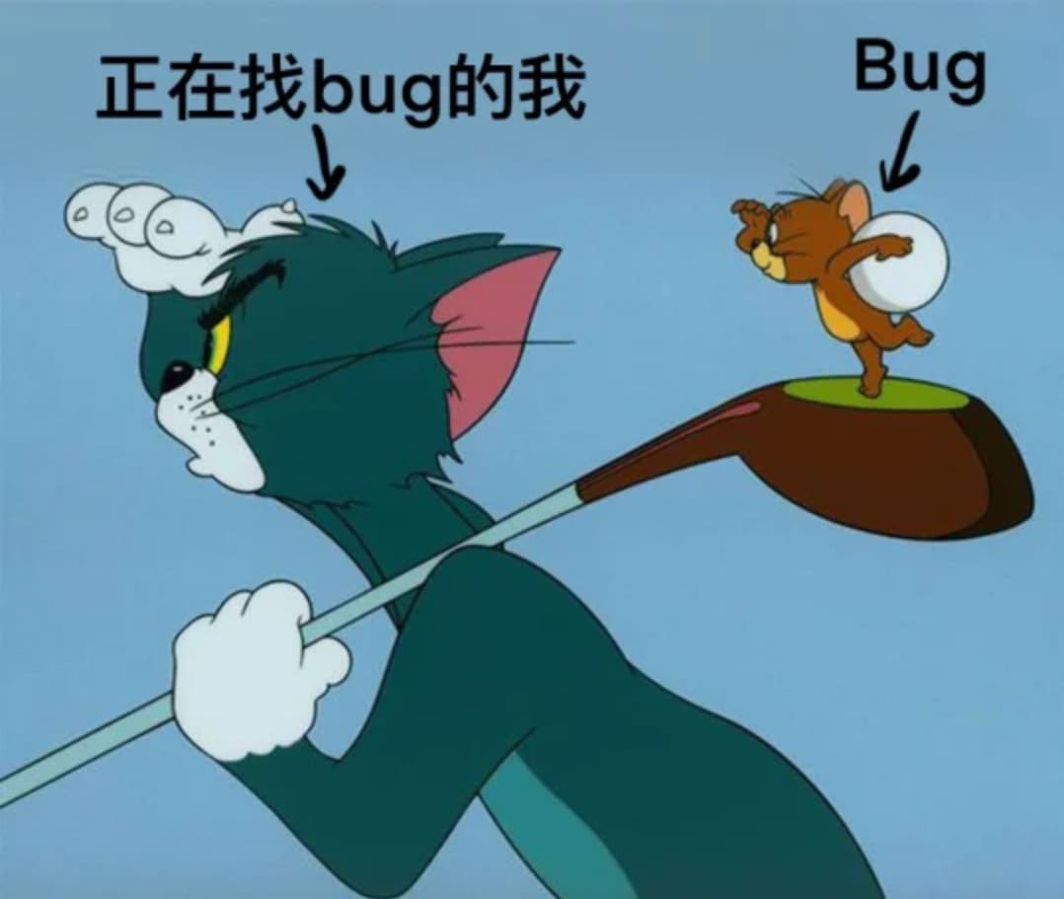
You are looking for a bug
Bug
And your prior knowledge may be wrong
Credit: Warner Bros.

Slide 66
Background / Software Testing
A serious software problem identified before launch
Sometimes new software cannot be started after software update, so PQ is still using the old software.
Software update is critical for PQ, since the team did not finish all onboard software before the launch.
In fact, we found other serious problems in orbit, which could only be fixed by software update.

Slide 67
Background / Software Testing
So why couldn’t we identify it earlier?
Output looked correct, except the software version MD5. Nobody checked the MD5 string.
We assumed that errors located in the software update precedure. However, it occured after the procedure.
The error only occured when several conditions were satisfied.

Slide 68
Background / Software Testing
Traditionally, how to reduce human effort and prior knowledge in software testing?

Slide 69
Background / Software Testing
Model-based test generation, e.g., human specify a finite state machine (FSM) of system under test and use a tool to traverse the FSM. The traversal paths are recorded as test cases.
Symbolic execution substitutes all program variables with symbolic values, simulates execution of tested software step by step with constraint solving, and looks for all executable paths
Random testing, i.e., select commands randomly.
Search-based testing, use evolutionary algorithms (like the genetic algorithm) to modify a test cases written by human.

Slide 70
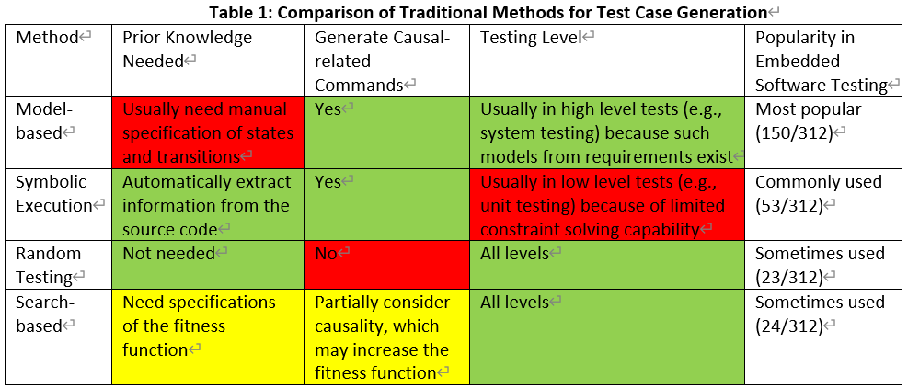
Background / Software Testing

Slide 71
Background / Software Testing
Only search-based testing can deal with this situation:
No model exists (our case)
System-level testing (our case)
Also achieve testing goals other than code coverage (helpful)

Slide 72
Background / Software Testing
But traditional search-based testing with evolutionary algorithms has shortages:
Discard information observed at each test case step. Only use final objective function of the whole test case.
Output a fixed solution, which may not work well in a non-deterministic environment.
Cannot learn the pattern of a series of software. Testers need to re-run the time-consuming algorithm in regression testing.

Slide 73
Background / Software Testing
How to solve these challenges?
You can look from a view of AI researchers.

Slide 74
Background
About Delfi-PQ
Software Testing
Sequential Decision Making
RL-Based Testing

Slide 75
Background
About Delfi-PQ
Software Testing
Sequential Decision Making
RL-Based Testing

Slide 76
Background / Sequential Decision-Making
Software testing is a sequential decision-making process.

Slide 77
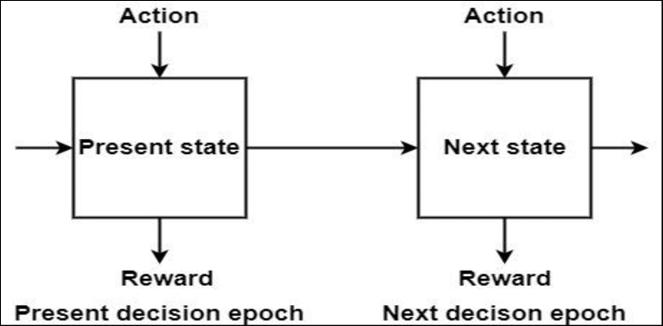
Background / Sequential Decision-Making
Strøm, M. A., Rehn, C. F., Pettersen, S. S., Erikstad, S. O., Asbjørnslett, B. E., & Brett, P. O. (2018). Combining design and strategy in offshore shipping. In Marine Design XIII (pp. 147-162). CRC Press.

Slide 78
Background / Sequential Decision-Making
Depending on how knowledge is encoded:
- Symbolism encodes knowledge with symbols, which are interpretable.
- Connectionism encodes knowledge neural networks.
Depending on action space:
- Discrete. There are limited number of actions.
- MultiDiscrete. Select n discrete actions in a step.
- Continuous.

Slide 79
Background / Sequential Decision-Making
Depending on underlying techniques:
- If the state/action space is small and discrete, a state machine is enough. Variants include procedures and petri nets,
- If the state/action space is large but discrete, you can try implicit graph search. Examples are classical planning and expert systems.
- If the state/action space is continuous, you may transfer it to an optimization problem, which can be solved by gradient descent, mathematical programing, evolutionary algorithms, etc.
- Sometimes you can directly calculate the action with formulars, like PID control.
- Learning is fitting an implicit function to calculate the result (supervised / unsupervised / reinforcement learning)

Slide 80
Background / Sequential Decision-Making
If we look back at the test case generation methods:
- Model-based testing: state machine + graph search
- Symbolic execution: implicit graph search
- Random testing: no decision making
- Search-based testing with evolutionary algorithms: optimization

Slide 81
Background / Sequential Decision-Making
Note that we widely use sequential decision-making techniques in space industry.

Slide 82
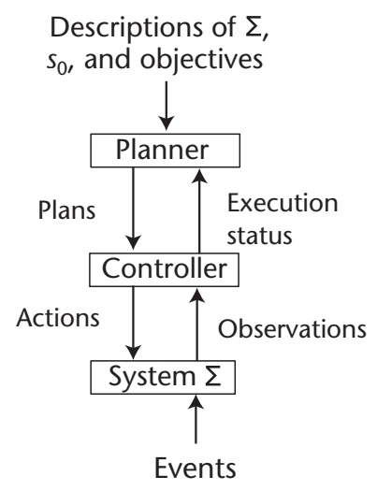
Background / Sequential Decision-Making
Task Planning:
- Focus on “what to do”.
- It usually uses graph search techniques.
- 1st planner for space is DEVISER by NASA JPL for
the Voyager mission (early 1980s).
- 1st onboard planner is the PS module by NASA Ames
Center for the Deep Space-1 mission (1998).
- Recent mission: Perseverance Mars rover (ground
planner, NASA JPL, 2020), Amazônia-1 satellite (onboard
planner, Brazil, 2021)
Nau, D. S. (2007). Current trends in automated planning. AI magazine, 28(4), 43-43.

Slide 83
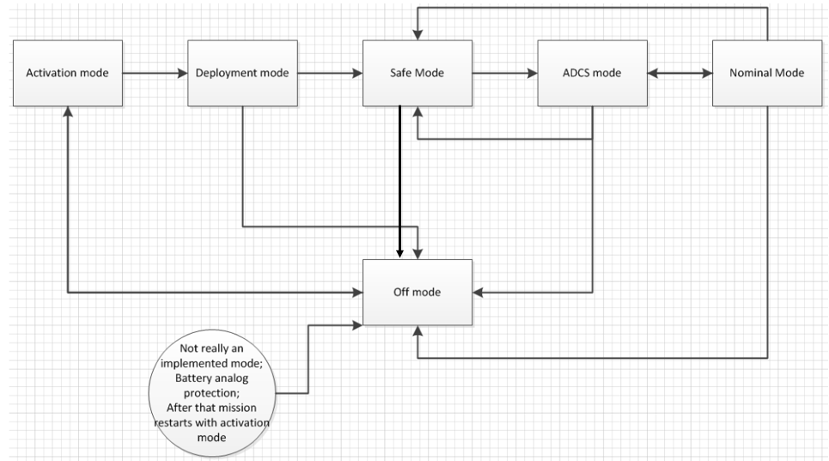
Background / Sequential Decision-Making
State Machine:
- If the mission is simpler, you do not need complex task planning
State machine in Delfi-PQ OBC
(credit: Silvana Radu)

Slide 84
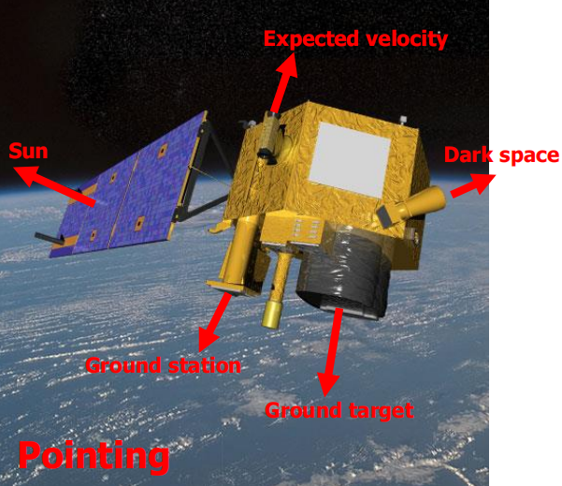
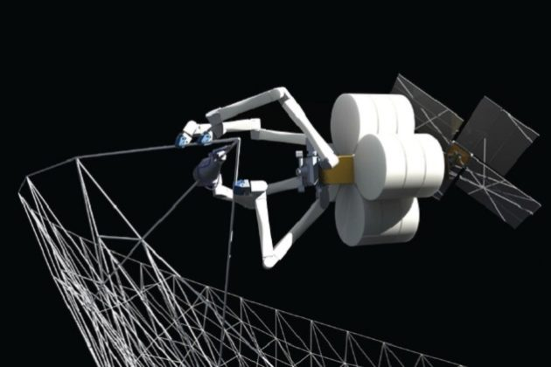
Background / Sequential Decision-Making
Control:
- Low-level actions. Calculate with formulars/optimization.
Attitude control
(credit: Jian Guo)
Free-floating arm control
(credit: Tether Unlimit)
Nau, D. S. (2007). Current trends in automated planning. AI magazine, 28(4), 43-43.

Slide 85
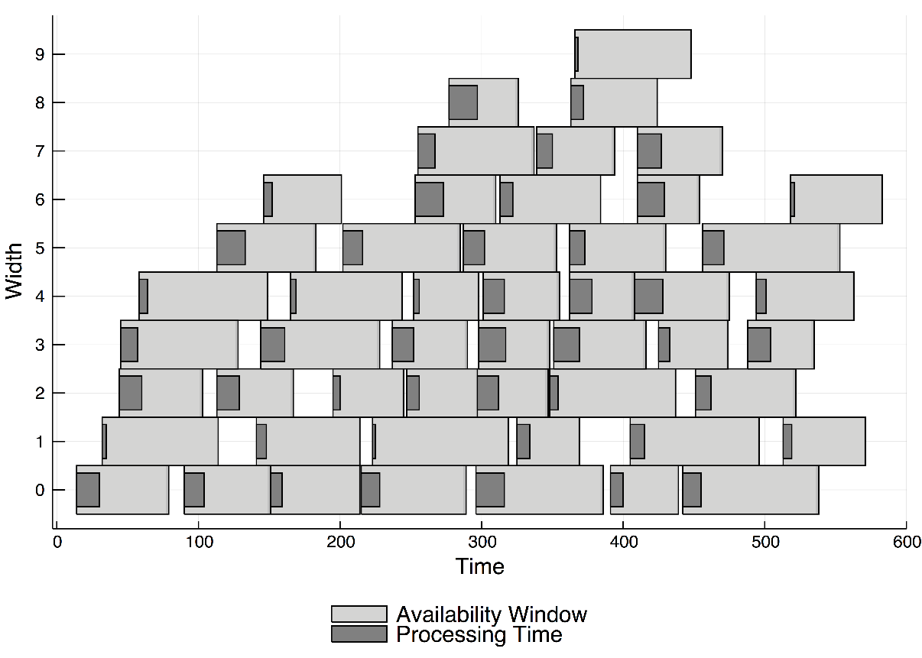
Background / Sequential Decision-Making
Scheduling:
- Focus on “when to do”.
- Schedule observation/communication.
- Transfer it to an optimization problem.
- A famous scheduler is SPIKE for the
Hubble Space Telescope (1990) and James
Webb Telescope (2021), developed by
STScI.
Weerdt, M. de (2021). What have satellite scheduling, the selected traveling salesperson problem, and make-to-order manufacturing in common? MultiParty Planning and Optimization.

Slide 86
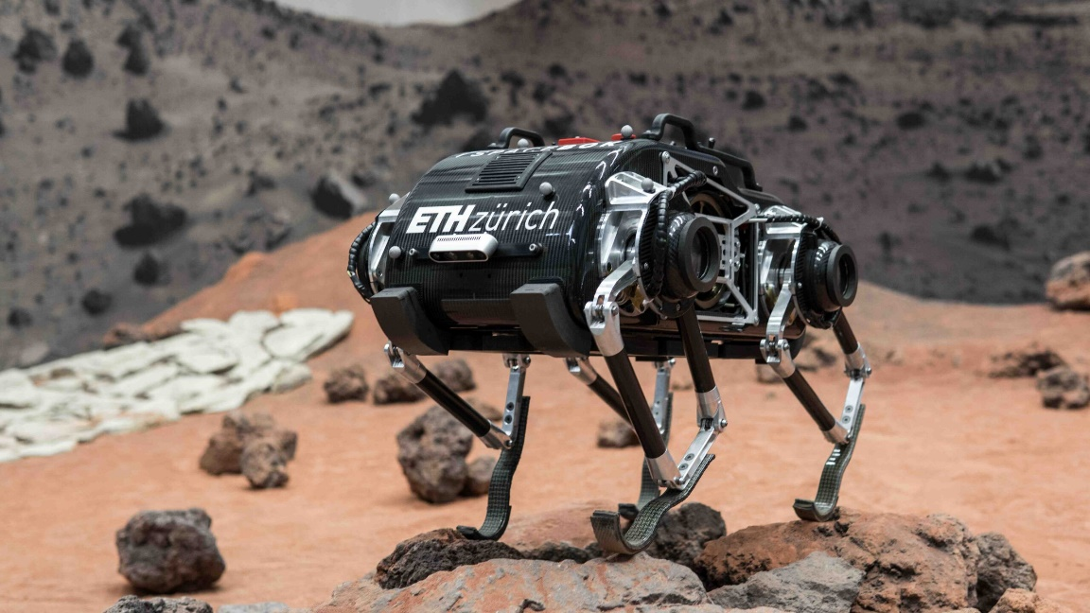
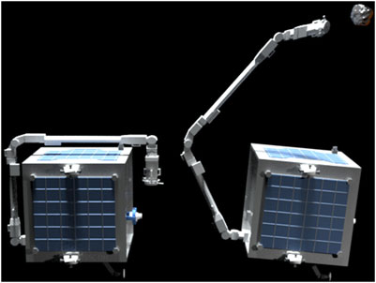
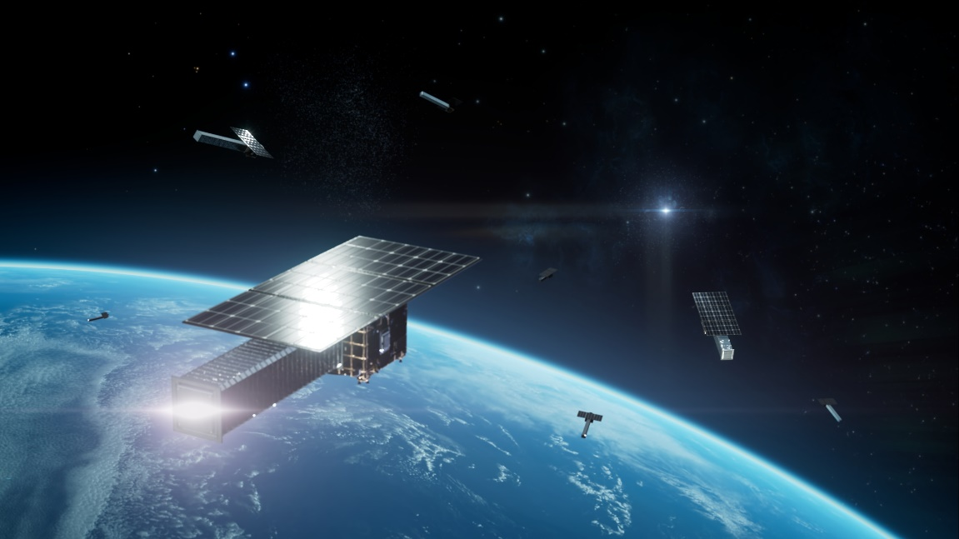
Background / Sequential Decision-Making
Two representative learning techniques for sequential decision-making in space are reinforcement learning and imitation learning
locomotion robot
(credit: ETH & ESA)
Robot arm manipulation
(credit: Surrey space center)
Multi-agent observation scheduling
(credit: NSSC & Tencent)
Izzo, D., Märtens, M., & Pan, B. (2019). A survey on artificial intelligence trends in spacecraft guidance dynamics and control. Astrodynamics, 3(4), 287-299.

Slide 87
Background / Sequential Decision-Making
Use RL in onboard software testing on the ground?
Safe & Cheap,
Good computing power/tool chain,
Collecting millions of samples is OK,
Clear reward definition

Slide 88
Background
About Delfi-PQ
Software Testing
Sequential Decision Making
RL-Based Testing

Slide 89
Background
About Delfi-PQ
Software Testing
Sequential Decision Making
RL-Based Testing

Slide 90
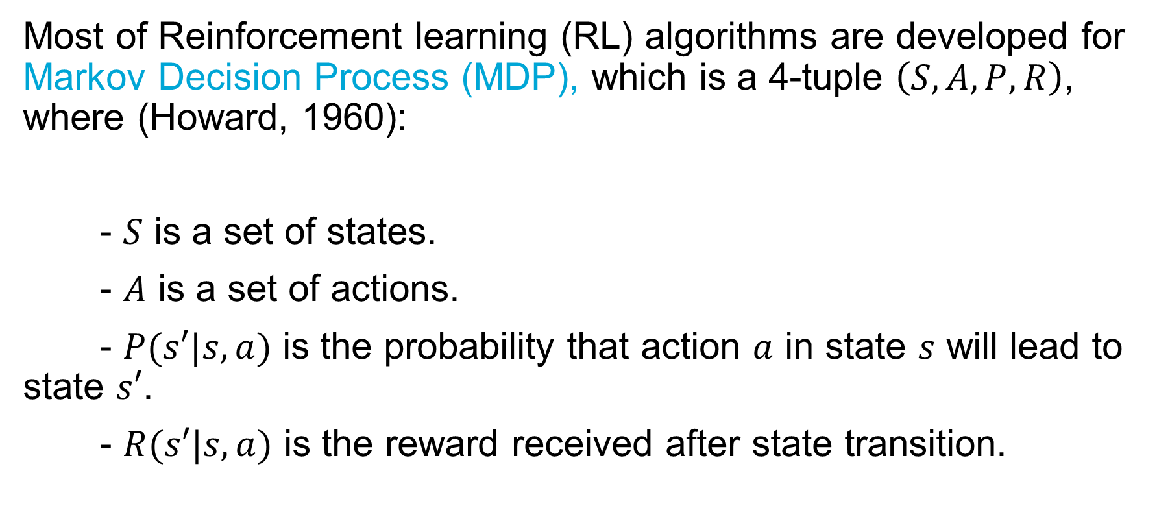
Background / RL-Based Testing
Most of Reinforcement learning (RL) algorithms are developed for Markov Decision Process (MDP), which is a 4-tuple $\left(S,A,P,R\right)$, where (Howard, 1960):
- $S$ is a set of states.
- $A$ is a set of actions.
- $P(s′|s,a)$ is the probability that action $a$ in state $s$ will lead to state $s′$.
- $R(s′|s,a)$ is the reward received after state transition.

Slide 91
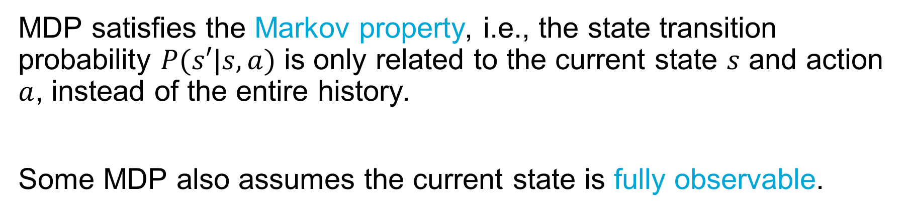
Background / RL-Based Testing
MDP satisfies the Markov property, i.e., the state transition probability $P(s′|s,a)$ is only related to the current state $s$ and action $a$, instead of the entire history.
Some MDP also assumes the current state is fully observable.

Slide 92

Background / RL-Based Testing
In an MDP step, RL does the following things:
1. Observe the environment
2. Select an action according to the estimated policy function, value function, or environment model.
3. Receive a reward (scalar).
4. Update the approximators of policy function, value function, or environment model.
Credit: Technik und Wissen

Slide 93
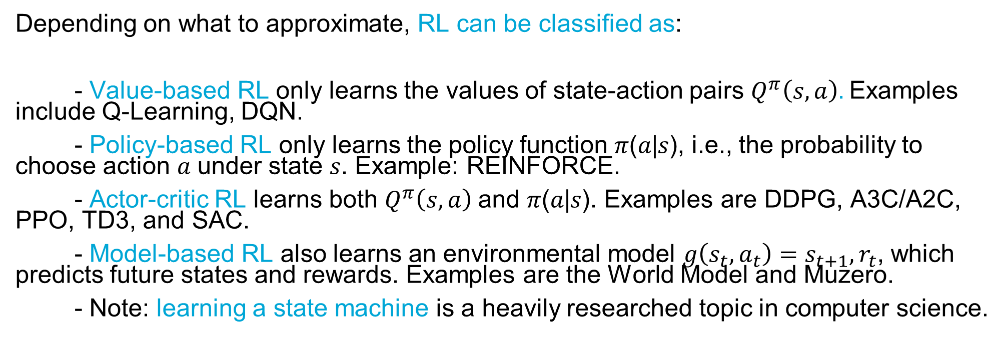
Background / RL-Based Testing
Depending on what to approximate, RL can be classified as:
- Value-based RL only learns the values of state-action pairs $Q^{π}\left(s,a\right).$Examples include Q-Learning, DQN.
- Policy-based RL only learns the policy function 𝜋(𝑎|𝑠), i.e., the probability to choose action 𝑎 under state 𝑠. Example: REINFORCE.
- Actor-critic RL learns both $Q^{π}\left(s,a\right)$and 𝜋(𝑎|𝑠). Examples are DDPG, A3C/A2C, PPO, TD3, and SAC.
- Model-based RL also learns an environmental model $g\left(s_{t},a_{t}\right)=s_{t+1},r_{t}$, which predicts future states and rewards. Examples are the World Model and Muzero.
- Note: learning a state machine is a heavily researched topic in computer science.

Slide 94
Background / RL-Based Testing
Traditional Methods does NOT satisfy our requirements
RL-Based Testing
- No model exists (our case)
- System-level testing (our case)
- Achieve different testing goals (helpful)
- Fully utilize observation at each step (helpful)
- Adapt to non-deterministic environment (helpful)
- Work in regression testing (helpful)
- At any testing level
- Accept computable testing goals
- A model is unnecessary
- Use observation
- Learn a policy, which can be used in non-derterministic environments
- May learn the pattern in a series of software
It’s real-time testing command geneation.

Slide 95
Background / RL-Based Testing
One of the benifits: use RL in regression testing
Train the agent in sprint 1
Run the agent in sprint 2, and train it at the same time

Slide 96
Background / RL-Based Testing
RL-based testing in getting popular in other fields, but not space industry and embedded SW testing yet...
Bytedance, the company of TikTok, runs their RL agent Fastbot >10000 times per day, find >50000 crashes per month (2021).
Electronic Arts, who made Need For Speed and Call of Duty, now use RL to test first-person shooter games (Bergdahl, 2020).
Commercial RL-based testing tool providers: Test.AI (mobile app GUI testing, 2021), Diffblue cover (unit testing for Java, 2021), etc.

Slide 97
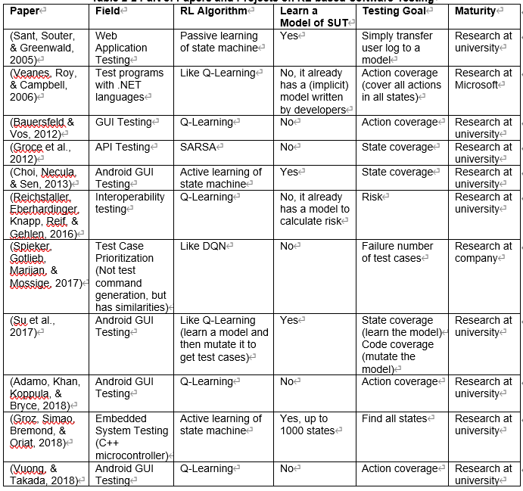
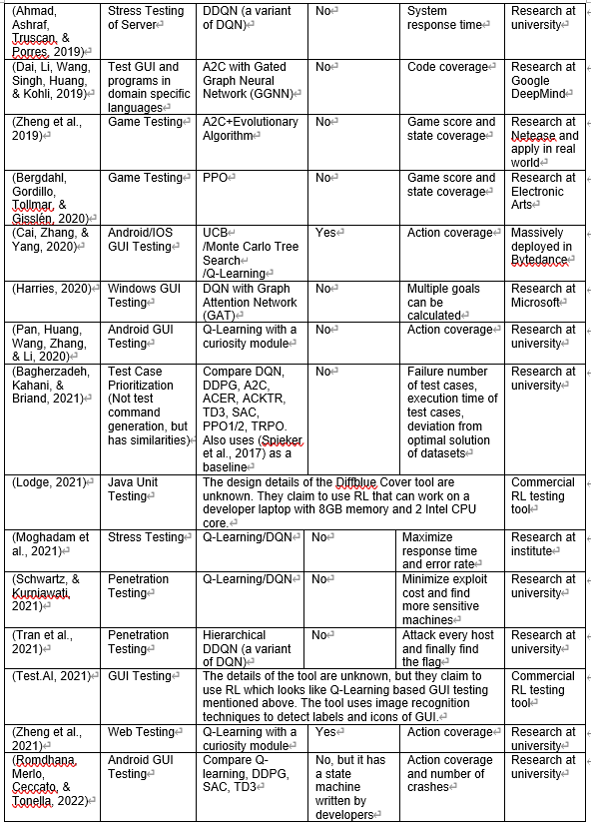
Background / RL-Based Testing
Comprehensive review of previous RL-based SW testing studies in section 2.3

Slide 98
Background / RL-Based Testing
Comprehensive review of previous RL-based SW testing studies in section 2.3
Research started from 2005.
Application started from 2019.

Slide 99
Background / RL-Based Testing
Why not use RL to test embedded SW / onboard SW?
Space industry is a little conservative…
Difficult to extract current state:
- Embedded SW doesn’t have GUI.
- The telemetry is not a complete description of state. For PQ, it only shows the satellite is healthy or not.
- RL with partial observation is more complex.
Difficult to define actions:
- You need to keep the spacecraft (SC) safe.
- SC has multiple inputs (commands, sensor readings, radio…)

Slide 100
Background / RL-Based Testing
Why not use RL to test embedded SW / onboard SW?
Difficult to define rewards:
- State coverage is hard, since you don’t know the current state
- Interface coverage, i.e., collecting every type of replies, may not be sufficient
- Requirement coverage needs prior knowledge
Difficult to perform multi-system testing:
- You have host PC, subsystem A/B/C on the same bus
- Limited communication, compared with test SW on the same computer

Slide 101
Background / RL-Based Testing
First one in this field.
Difficult life.

Slide 102
Content
Overview
Background
Method
Experiments
Conclusions & Recommendations

Slide 103
Content
Overview
Background
Method
Experiments
Conclusions & Recommendations

Slide 104
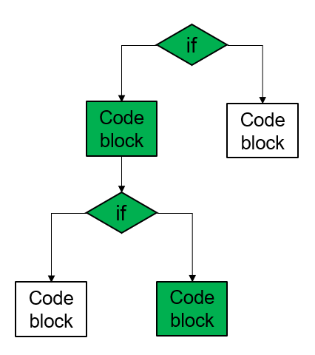
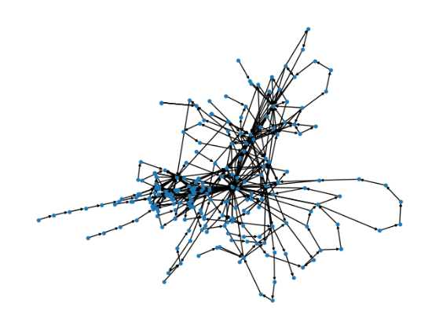
Method
Last human-defined state (scalar)
Human specified rules
Last command
Current human-defined state (scalar)
Function approximators
Current reply
RL algorithm
Action
(next command)
Automatically collected information, e.g., code coverage
Embedding
(vector / graph)
Receive reward
[0, 1, …0]
With support from low-level hardware/software

Slide 105
Method
Last human-defined state (scalar)
Human specified rules
Last command
Current human-defined state (scalar)
Function approximators
Current reply
RL algorithm
Action
(next command)
Automatically collected information, e.g., code coverage
Embedding
(vector / graph)
Receive reward
[0, 1, …0]
With support from low-level hardware/software

Slide 106
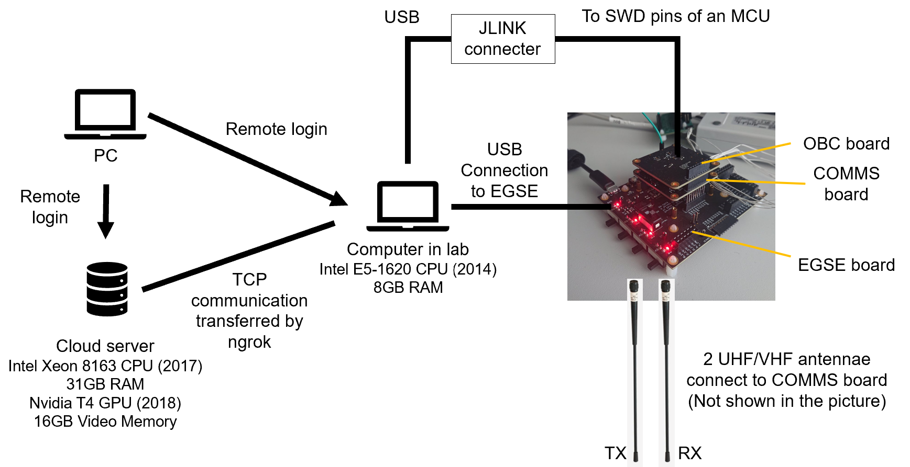
Method/low-level hardware

Slide 107
Method/low-level hardware
It can do single/multiple subsystem testing.
But I only test COMMS in the study.

Slide 108
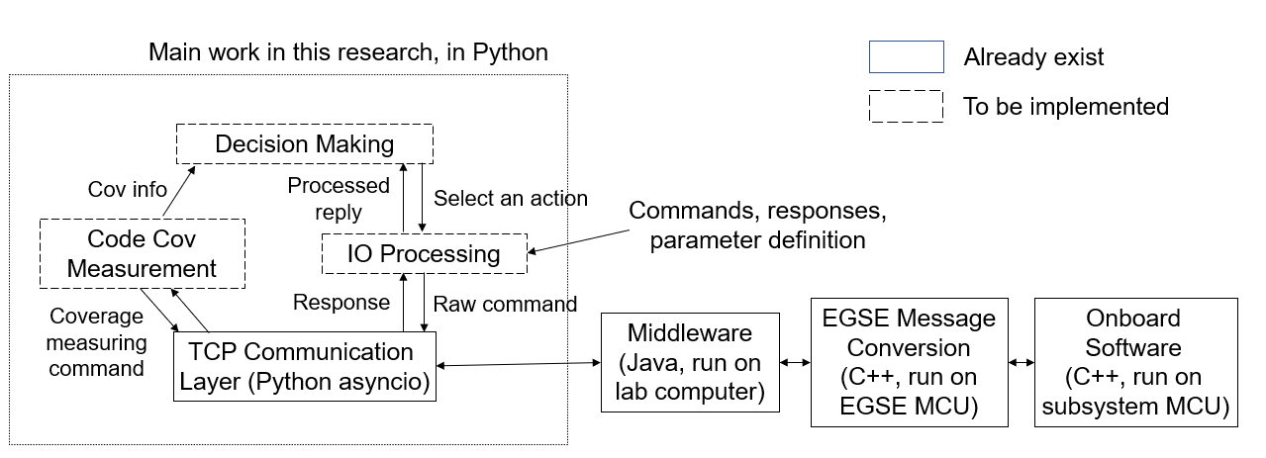
Method / low-level software
Software layout

Slide 109
Method
Last human-defined state (scalar)
Human specified rules
Last command
Current human-defined state (scalar)
Function approximators
Current reply
RL algorithm
Action
(next command)
Automatically collected information, e.g., code coverage
Embedding
(vector / graph)
Receive reward
[0, 1, …0]
With support from low-level hardware/software

Slide 110
Method
Last human-defined state (scalar)
Human specified rules
Last command
Current human-defined state (scalar)
Function approximators
Current reply
RL algorithm
Action
(next command)
Automatically collected information, e.g., code coverage
Embedding
(vector / graph)
Receive reward
[0, 1, …0]
With support from low-level hardware/software

Slide 111
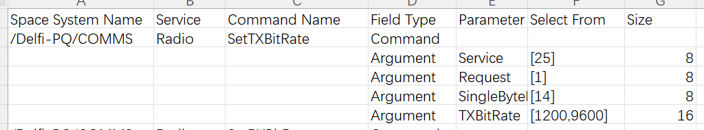
Method / action
Actions in Discrete action space:
Human define the format, order, and values of command parameters in a csv file.
IO processing module generates a command list.
RL agent select a command from the list.

Slide 112
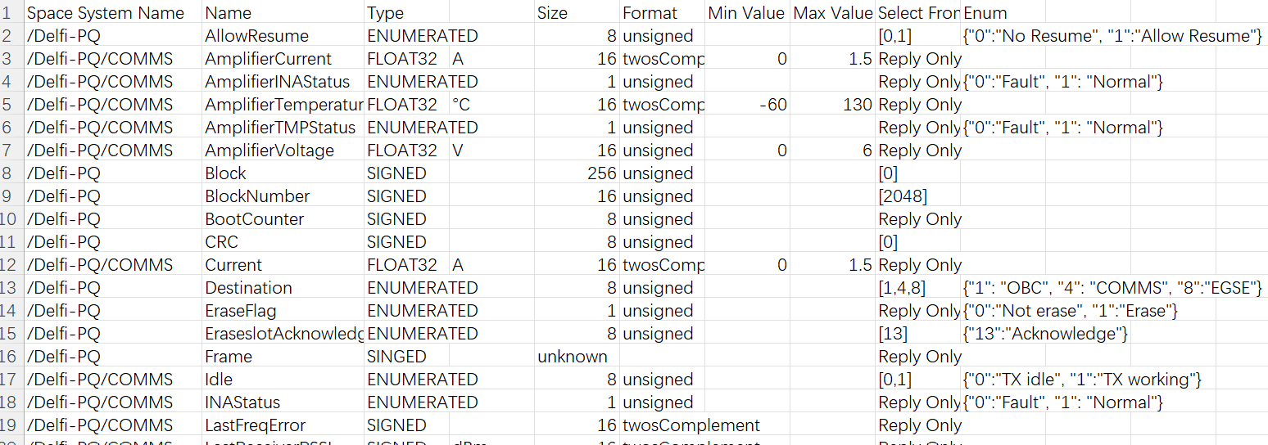
Method / action
Actions in MultiDiscrete action space:
Human define possible parameter values in a csv file.
RL agent select the values to form a command vector, whose length is set by human.
[data 1, data 2, data 3, …, data N]
Parameter list

Slide 113
Method / action
Discrete: safer
MultiDiscrete: less prior knowledge

Slide 114
Method
Last human-defined state (scalar)
Human specified rules
Last command
Current human-defined state (scalar)
Function approximators
Current reply
RL algorithm
Action
(next command)
Automatically collected information, e.g., code coverage
Embedding
(vector / graph)
Receive reward
[0, 1, …0]
With support from low-level hardware/software

Slide 115
Method
Last human-defined state (scalar)
Human specified rules
Last command
Current human-defined state (scalar)
Function approximators
Current reply
RL algorithm
Action
(next command)
Automatically collected information, e.g., code coverage
Embedding
(vector / graph)
Receive reward
[0, 1, …0]
With support from low-level hardware/software

Slide 116
Method / reward
Possible rewards:
State coverage
Requirement coverage
Risk
Code coverage
CPU loads
…

Slide 117
Method / reward
Possible rewards:
State coverage
Requirement coverage
Risk
Code coverage
CPU loads
…
Significant prior knowledge
Difficulty to define risk
Computable

Slide 118
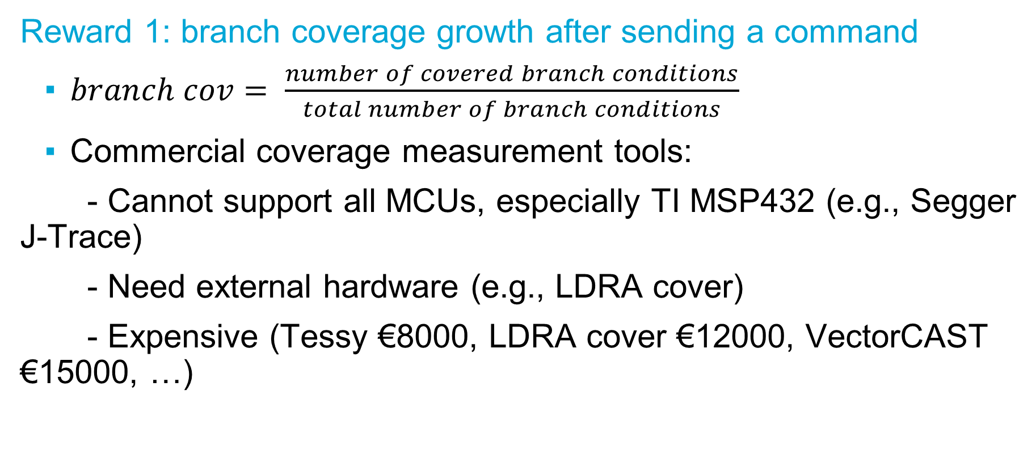
Method / reward
Reward 1: branch coverage growth after sending a command
$branch cov= \frac{number of covered branch conditions}{total number of branch conditions}$
Commercial coverage measurement tools:
- Cannot support all MCUs, especially TI MSP432 (e.g., Segger J-Trace)
- Need external hardware (e.g., LDRA cover)
- Expensive (Tessy €8000, LDRA cover €12000, VectorCAST €15000, …)

Slide 119
Method / reward
Thus, make our own tool.

Slide 120
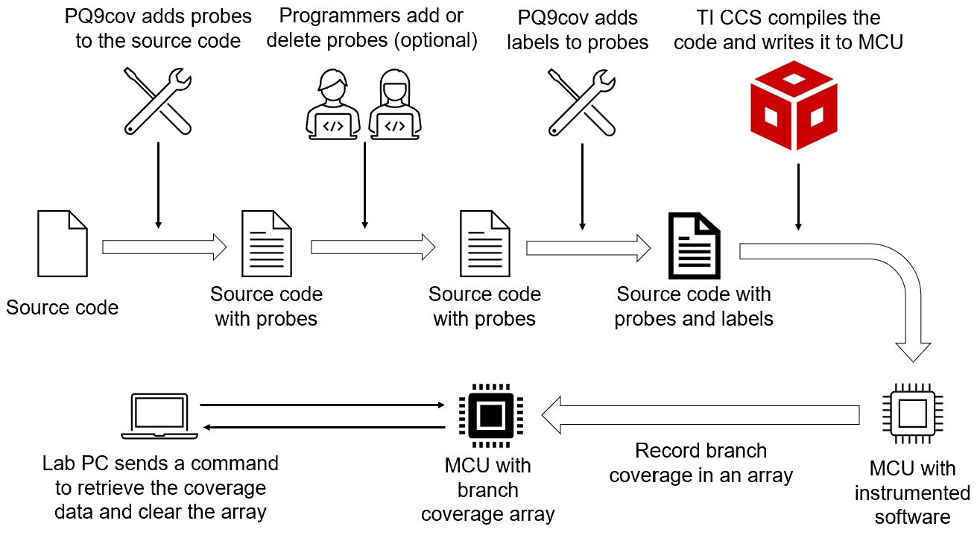
Method / reward

Slide 121
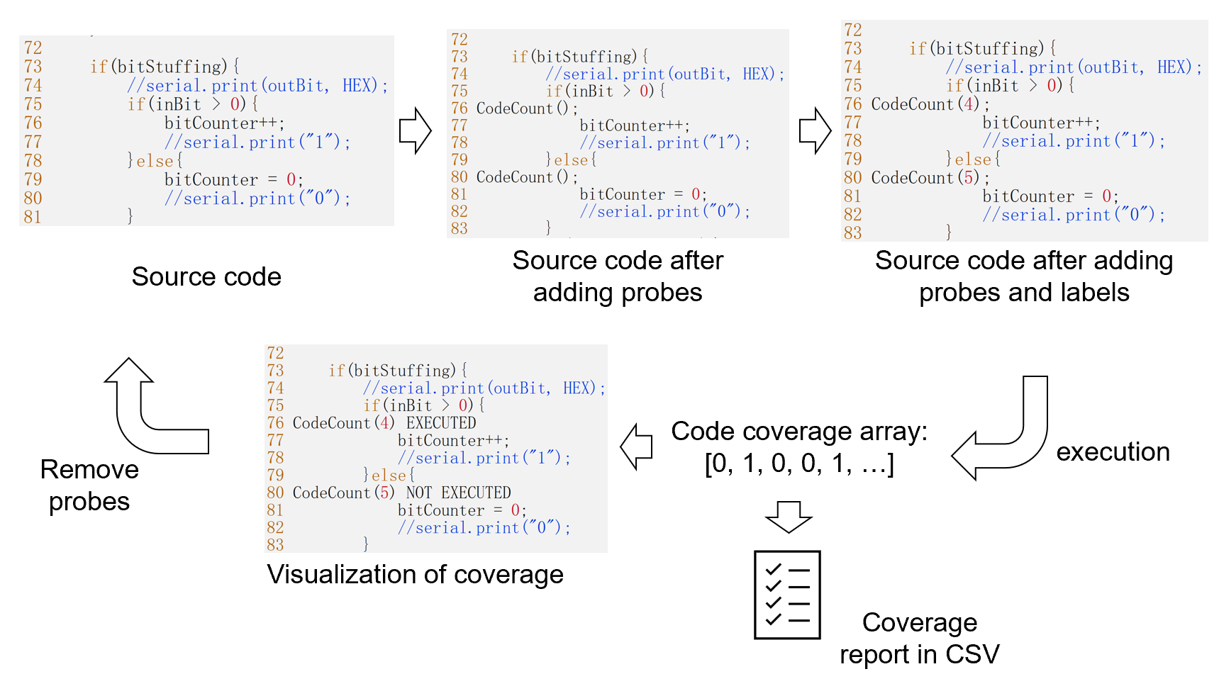
Method / reward

Slide 122
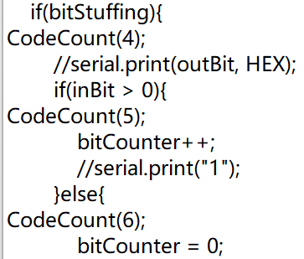
Method / reward
Reward 1: branch coverage growth after sending a command
Coverage tool made in house (github.com/StarCycle/CodeCoverage)
- Insert CodeCount() function in every branch, using regression expressions.
- Low memory footprint
Each CodeCount result is stored in 1 bit.
COMMS: 716 CodeCounts, 90 byte
OBC: 1329 CodeCounts, 167 byte
Max payload size: 253 byte

Slide 123
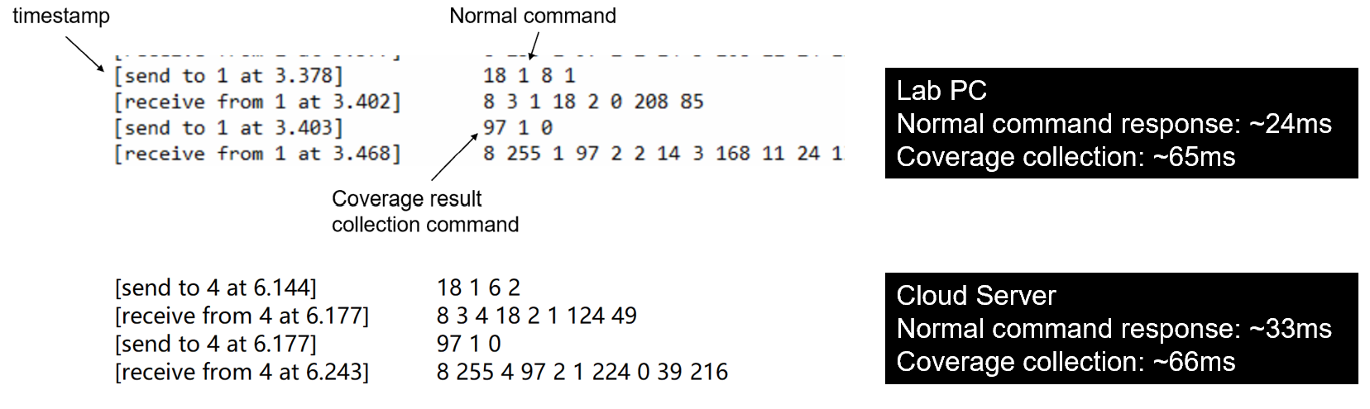
Method / reward
Reward 1: branch coverage growth after sending a command:
Coverage tool made in house (github.com/StarCycle/CodeCoverage)
- Quick data transmission -> can do near real-time measurement

Slide 124
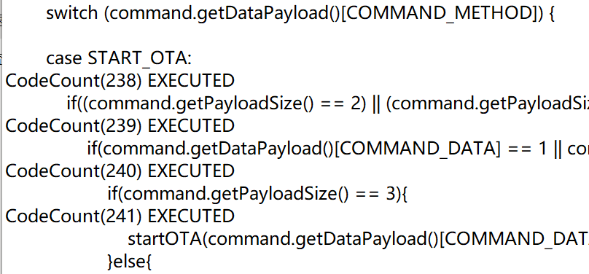
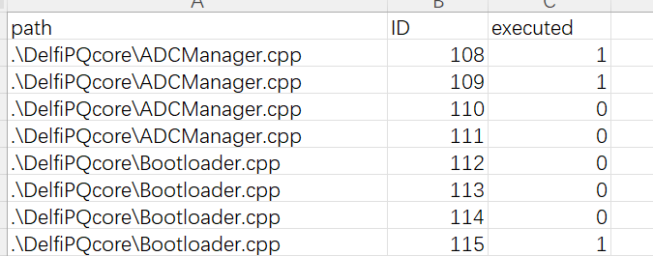
Method / reward
Reward 1: branch coverage growth after sending a command
Coverage tool made in house (github.com/StarCycle/CodeCoverage)
- Coverage report:

Slide 125
Method / reward
Theoretically, the tool can measure near real-time code coverage from any programming language, any MCU, and via any bus.
It still has problems:
1. Only support branch coverage
2. Not very accurate because it uses regrex to parse the code
3. Hitting CodeCount() takes time!
But now it’s sufficient to calculate rewards. And these can be improved.

Slide 126
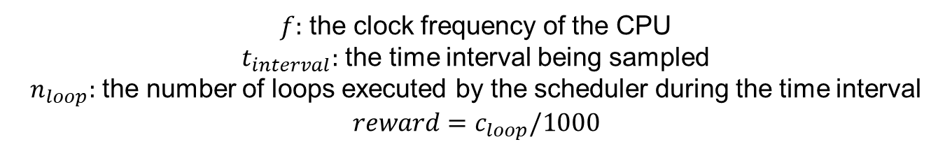
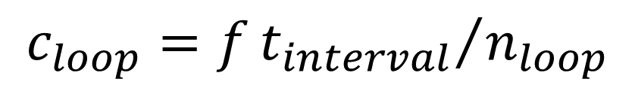
Method / reward
Reward 2: Estimated CPU load
Estimate number of clock cycles required by each loop in the scheduler
$$c_{loop}=f{t_{interval}}/{n_{loop}}$$
$f:$ the clock frequency of the CPU
$t_{interval}:$ the time interval being sampled
$n_{loop}:$ the number of loops executed by the scheduler during the time interval
$$reward=c_{loop}/1000$$

Slide 127
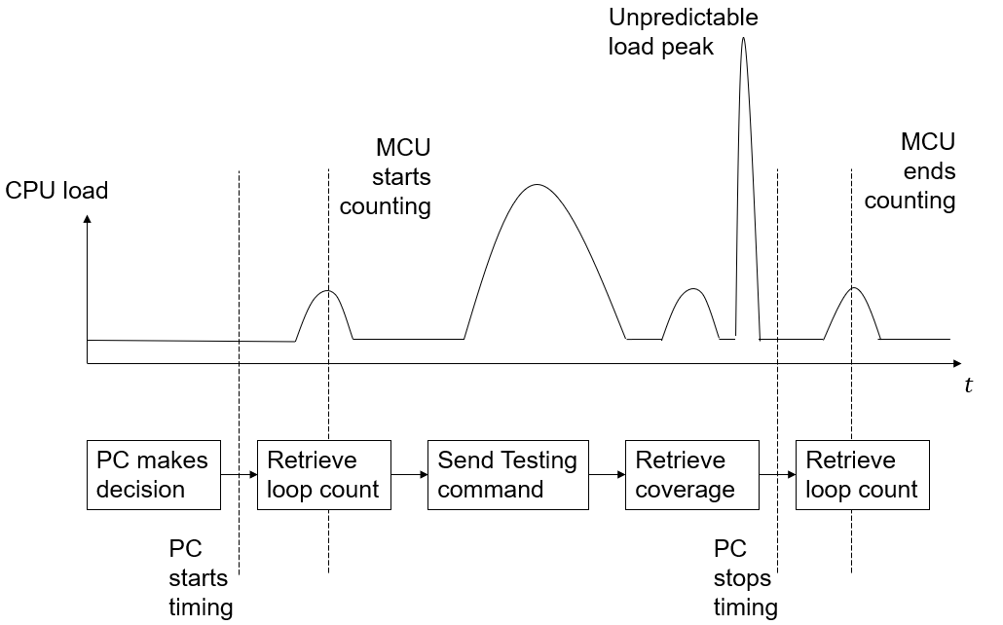
Method / reward
Reward 2: Estimated CPU load

Slide 128
Method / reward
Reward 2: Estimated CPU load
Make CPU load uncertain

Slide 129
Method
Last human-defined state (scalar)
Human specified rules
Last command
Current human-defined state (scalar)
Function approximators
Current reply
RL algorithm
Action
(next command)
Automatically collected information, e.g., code coverage
Embedding
(vector / graph)
Receive reward
[0, 1, …0]
With support from low-level hardware/software

Slide 130
Method
Last human-defined state (scalar)
Human specified rules
Last command
Current human-defined state (scalar)
Function approximators
Current reply
RL algorithm
Action
(next command)
Automatically collected information, e.g., code coverage
Embedding
(vector / graph)
Receive reward
[0, 1, …0]
With support from low-level hardware/software

Slide 131
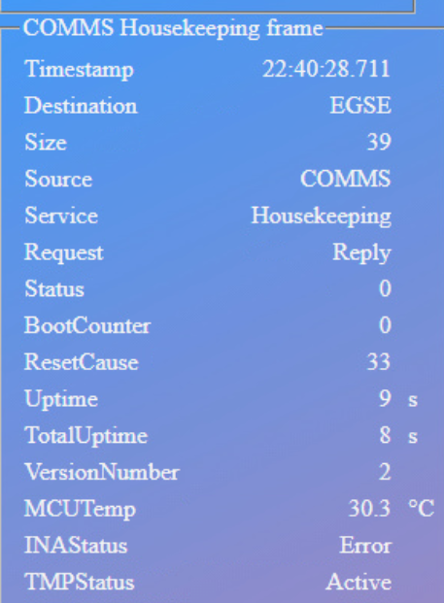
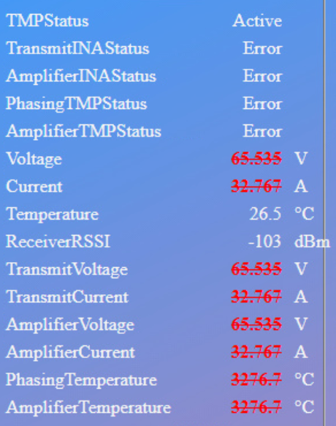
Method / human-specified state
Housekeeping telemetry is not enough to derive system state:
What can you get from housekeeping telemetry?
Useless fields
They will NOT even change during a test

Slide 132
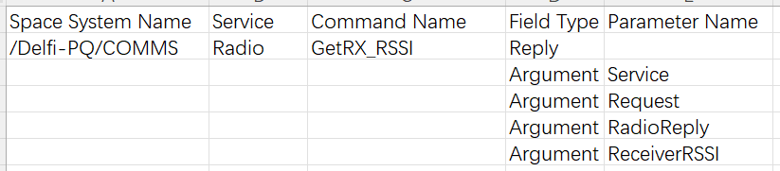
Method / human-specified state
You need more information to derive system state:
Which command has been executed and their replies show current state of the system.
if (last_state == xxx
&& command == xxx
&& reply == xxx):
current_state=xxx
Command Definition
Reply Definition
State Extraction by rules

Slide 133
Method / human-specified state
More complex than I expected at the beginning…but it’s engineering.
Can reuse it in other PQ software.

Slide 134
Method / human-specified state
Human-specified states use too much prior knowledge.

Slide 135
Method
Last human-defined state (scalar)
Human specified rules
Last command
Current human-defined state (scalar)
Function approximators
Current reply
RL algorithm
Action
(next command)
Automatically collected information, e.g., code coverage
Embedding
(vector / graph)
Receive reward
[0, 1, …0]
With support from low-level hardware/software

Slide 136
Method
Last human-defined state (scalar)
Human specified rules
Last command
Current human-defined state (scalar)
Function approximators
Current reply
RL algorithm
Action
(next command)
Automatically collected information, e.g., code coverage
Embedding
(vector / graph)
Receive reward
[0, 1, …0]
With support from low-level hardware/software

Slide 137
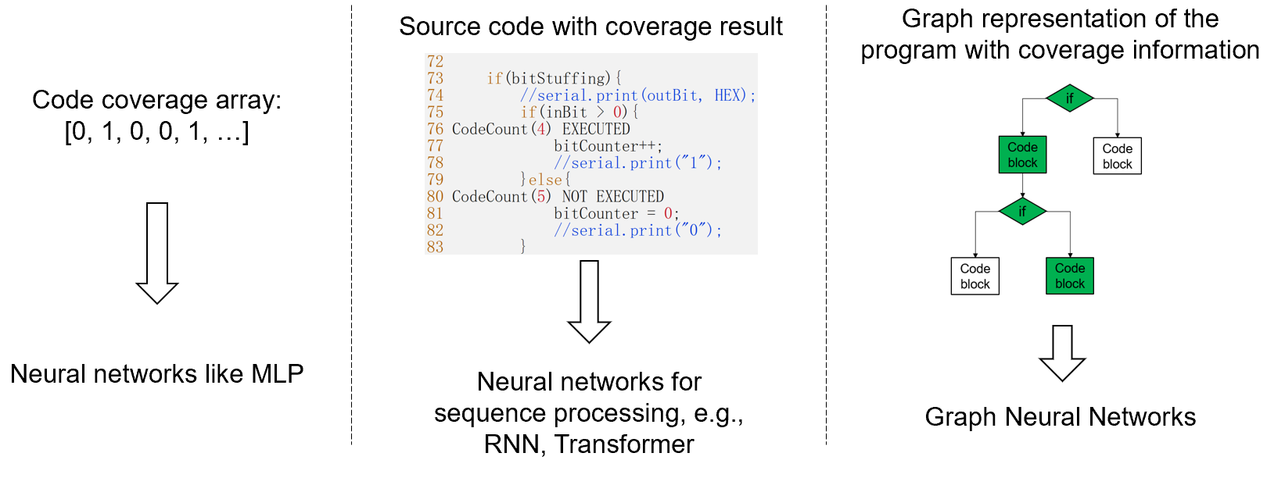
Method / automatic embedding of state

Slide 138
Method / automatic embedding of state
Robust and straightforward, but…

Slide 139
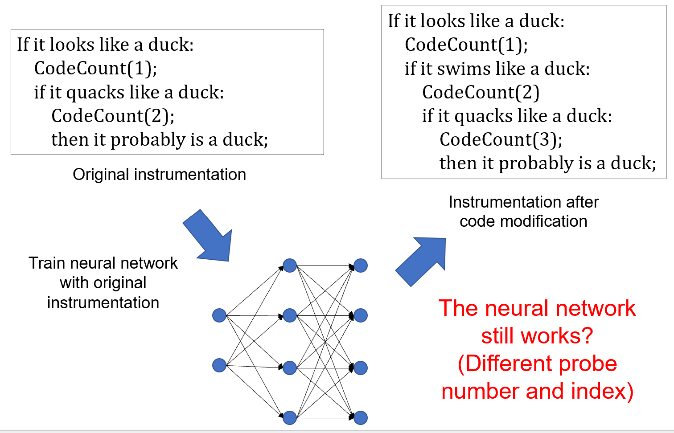
Method / automatic embedding of state
NOT suitable for regression testing

Slide 140
Method / automatic embedding of state
Input is too long. Difficult to train.

Slide 141
Method / automatic embedding of state
So, I choose graph
Each node contains
- Information of this branch
- Whether the branch is covered
Directed edges have no weights
CodeCount(1)
CodeCount(2)
CodeCount(3)
CodeCount(4)

Slide 142
Method / automatic embedding of state
How to build this graph?
You can use coverage measurement
Embedded SW updates the following array:
And host PC samples the array periodically
LastCodeCount
CodeCount(121)
index
121 | 122 | 123
122 | 123 | 124
...
value
CodeCount(122)
CodeCount(123)
CodeCount(124)

Slide 143
Method / automatic embedding of state
When the current CodeCount is 124, the previous CodeCount is 123
CodeCount(121)
CodeCount(122)
index
122 | 123 | 124
121 | 122 | 123
...
value
CodeCount(123)
Periodically sample the array and add edges to the graph
CodeCount(124)

Slide 144

Method / automatic embedding of state
Result:
Use coverage measurement to build control flow graph
COMMS has 716 CodeCounts
This method extracts 299, others not executed
For GNN, the graph structure is changing.
More communication load!
No information of a branch.

Slide 145
Method / automatic embedding of state
So, build this graph with static code analysis
TI Code Composer Studio can generate call graph, where each node is a function. However,
- There are too many functions from low-level libraries
- Cannot include a CodeCount() node
- Tool-dependent, and I cannot modify the tool
Other tools like CodeViz, rely on output from compilers like GCC and Clang. Unfortunately, they don’t support the old TI compiler we use

Slide 146
Method / automatic embedding of state
But there is an open-source tool for code analysis research.

Slide 147
Method / automatic embedding of state
A parser for research: Joern
- Parse C, C++, Java, Python, Bytecode, Kotlin, PHP…
- Parse source code even if you cannot compile it
- Flexible API
- Mainly built for code vulnerability scanning
Problems of Joern:
- Weak to find calling relations among methods
- The results contain errors

Slide 148
Method / automatic embedding of state
To use output of Joern:
To find calling relations, writing my own code with Joern API
Connect to all method with the same name
Not accurate, but each program will have a static and unique graph structure, which is enough for GNN to recognize each node.
Method, Console::log(char *test)
Method call, Console::log()
Method, Console::log(void)
Method, XXX::log()

Slide 149
Method / automatic embedding of state
To use output of Joern:
To find information of branches, use Word2Vec
Word2Vec is a basic natural language processing algorithm to turn a string to a vector.
First train Word2Vec with all source code.
For each branch, convert the method name and file name to vector.
Node vector is:
$$μ_{i}=\left({typeID}_{i} , , word2vec\left({methodName}_{i}\right)word2vec\left({fileName}_{i}\right)\right)$$

Slide 150
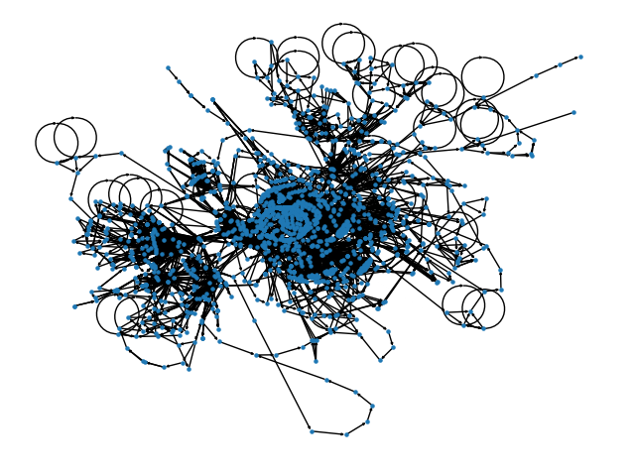
Method / automatic embedding of state
Result:
Control flow graph from static code analysis
1517 nodes, 3925 edges for COMMS
3 types of node: CodeCount, Method,
and MethodReturn
Still incomplete because of parsing
errors of Joern

Slide 151
Method
Last human-defined state (scalar)
Human specified rules
Last command
Current human-defined state (scalar)
Function approximators
Current reply
RL algorithm
Action
(next command)
Automatically collected information, e.g., code coverage
Embedding
(vector / graph)
Receive reward
[0, 1, …0]
With support from low-level hardware/software

Slide 152
Method
Last human-defined state (scalar)
Human specified rules
Last command
Current human-defined state (scalar)
Function approximators
Current reply
RL algorithm
Action
(next command)
Automatically collected information, e.g., code coverage
Embedding
(vector / graph)
Receive reward
[0, 1, …0]
With support from low-level hardware/software

Slide 153
Method / RL algorithm
This study tries three RL algorithms:
Q-Learning
D3QN: Dueling Double Deep Q Network
PPO: Proximal Policy Optimization
They are the most popular and robust RL algorithms
Note: Each algorithm may have several configurations

Slide 154
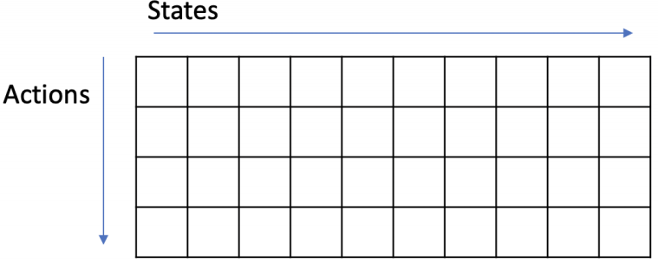

Method / RL algorithm
Q-Learning
Value-based RL, i.e., fitting the values of state-action pairs $Q^{π}\left(s,a\right).$
The approximator is a Q table.
A state in Q-Learning must be a scalar.
Thus, the scalar is extracted by rules, as mentioned before.
An action must be a scalar, too.
Thus, it only works in Discrete action space.

Slide 155


Method / RL algorithm
D3QN
Value-based RL, i.e., fitting the values of state-action pairs $Q^{π}\left(s,a\right).$
Variant of Q-Learning, use a neural network as the approximator.
State input can be a scalar, vector, or graph.
Actions should be Discrete, otherwise
Length of the command vector is L, the number of available values is V, then the network should predict $Q^{π}\left(s,a\right)$ for $V^{L}$ times
[17, 1, …2]

Slide 156

Method / RL algorithm
PPO
Actor-critic RL, i.e., fitting $Q^{π}\left(s,a\right)$ and 𝜋(𝑎|𝑠).
May crash when policy update (estimated by KL divergence) is too quick.
I add an annealing mechanism, i.e., if KL divergence is too high, reduce the learning rate.
State input can be a scalar, vector, or graph.
Actions should be Discrete or MultiDiscrete.

Slide 157
Method
Last human-defined state (scalar)
Human specified rules
Last command
Current human-defined state (scalar)
Function approximators
Current reply
RL algorithm
Action
(next command)
Automatically collected information, e.g., code coverage
Embedding
(vector / graph)
Receive reward
[0, 1, …0]
With support from low-level hardware/software

Slide 158
Method
Last human-defined state (scalar)
Human specified rules
Last command
Current human-defined state (scalar)
Function approximators
Current reply
RL algorithm
Action
(next command)
Automatically collected information, e.g., code coverage
Embedding
(vector / graph)
Receive reward
[0, 1, …0]
With support from low-level hardware/software

Slide 159

Method / Function Approximator
Neural Network Architecture
If input is a vector, then just use 2~3 layers of MLP (fully connected layer)
The input vector is a concatenation of 2 vectors:
The code coverage vector
(In Discrete action space) A vector containing actions in previous k steps.
Output $Q^{π}\left(s,a\right)$ or 𝜋(𝑎|𝑠)

Slide 160

Method / Function Approximator
Neural Network Architecture
If input is a graph, you need a graph neural network before the MLP
GNN
Graph with node features and edges. Code coverage is concatenated with node feature.
Graph pooling layer extract a graph embedding vector from node features.
GNN updates node features.
MLP
A vector containing actions in previous k steps (optional)

Slide 161

Method / Function Approximator
Hamilton, W. L., Ying, R., & Leskovec, J. (2017). Representation learning on graphs: Methods and applications. arXiv preprint arXiv:1709.05584.
GNN

Slide 162
Method / Function Approximator
GNN
This study tries 2 types of GNN: Gated Graph Neural Network (GGNN) and Graph Attention Network (GAT)
They appear in RL-based testing literature
GGNN uses a gated recurrent unit (GRU) to aggregate node features
GAT uses masked self-attention to aggregate node features (usually multi-head attention)

Slide 163
Method / Function Approximator
Graph Pooling Layer
This study tries many graph pooling mechanisms, but the following two are most useful.
Attentive pooling layer (for graph classification) in (Li, 2015).
Use an MLP to reduce node embeddings to scalars and then concatenate these scalars into a vector. I call it feature compression.

Slide 164
Method
Algorithm Configurations:
[RL algorithm] – [Action Space] – [Approximator]
Q-Learning
D3QN-Discrete-MLP
D3QN-Discrete-GGNN
D3QN-Discrete-GAT
PPO-Discrete-MLP
PPO-MultiDiscrete-MLP
PPO-Discrete-GGNN
PPO-Discrete-GAT
PPO-MultiDiscrete-GGNN

Slide 165
Method
The implementation is lightweight. It mainly uses PyTorch and PyTorch Geometry. Some RL algorithms are modified from ClearRL, a single-file RL repository.
Configuration | File Name | Number of Lines of Code
PPO-MultiDiscrete-GGNN | PPO.py | 166
 | GNN_Agent.py | 124
Shared functions | PQ9Client.py | 81
 | MyEnv.py | ~100
 | PQ9cov.py | 153
 | GraphExtract.py | 143
 | MyWord2Vec.py | 20

Slide 166
Method
Two Baselines
Random testing (Discrete, MultiDiscrete)
Genetic Algorithm (Discrete, MultiDiscrete)

Slide 167
Content
Overview
Background
Method
Experiments
Conclusions & Recommendations

Slide 168
Content
Overview
Background
Method
Experiments
Conclusions & Recommendations

Slide 169
Content
“Filling Grid” Test
Coverage Testing
Stress Testing
Regression Testing

Slide 170
Content
“Filling Grid” Test
Coverage Testing
Stress Testing
Regression Testing

Slide 171

Experiments / Filling Grid Test
First debug RL in a super simple environment

Slide 172
Experiments / Filling Grid Test
Example: successful training process of D3QN

Slide 173
Experiments / Filling Grid Test
Example: successful training process of PPO

Slide 174
Experiments / Filling Grid Test
Example: successful training process of PPO

Slide 175
Experiments / Filling Grid Test
Example: crashes of PPO without learning rate annealing

Slide 176
Experiments / Filling Grid Test
Findings about RL algorithms
Convergence speed: D3QN>PPO (just in this test).
Learning rate annealing avoids PPO from crashing. It also makes the final entropy higher but does not affect performance.
Findings about Neural Networks
Convergence speed: MLP>GGNN≈GAT, feature compression>attentive pooling
Performance: GGNN>=GAT
Stability: attentive pooling>feature compression

Slide 177
Content
“Filling Grid” Test
Coverage Testing
Stress Testing
Regression Testing

Slide 178
Content
“Filling Grid” Test
Coverage Testing
Stress Testing
Regression Testing

Slide 179
Experiments / Coverage Testing
Maximize branch coverage of COMMS software
Reward +1 when cover new branch, otherwise -1
The uncertainty is smaller than stress testing

Slide 180
Experiments / Coverage Testing
Findings
Random testing will finally reach the branch coverage up limit in 30 minutes.
Genetic algorithm finds optimal command sequence in an hour.
PPO-Discrete-MLP reaches similar performance as the genetic algorithm after 3 hours.
Other RL algorithms do not work or are unstable

Slide 181
Content
“Filling Grid” Test
Coverage Testing
Stress Testing
Regression Testing

Slide 182
Content
“Filling Grid” Test
Coverage Testing
Stress Testing
Regression Testing

Slide 183

Experiments / Stress Testing
Maximize estimated CPU load of COMMS software
${reward=c}_{loop}/1000$
Non-deterministic,
with unpredictable peaks
Sending the same command repeatedly

Slide 184
Experiments / Stress Testing
Genetic algorithm does not work very well because…
Genetic-Discrete

Slide 185
Experiments / Stress Testing
But RL performs well in such environment
PPO-MultiDiscrete-GGNN

Slide 186
Experiments / Stress Test
Findings about algorithms
Random testing does not work.
A fixed solution from the genetic algorithm is not suitable for such non-deterministic environment.
Q-Learning does not converge.
D3QN does not converge.
All PPO algorithms converge.
CPU load is much higher when the algorithm works within MultiDiscrete (for both genetic and PPO), if command vector length is not too long.
CPU load has smaller variance when the algorithm works within MultiDiscrete (for both genetic and PPO).

Slide 187
Experiments / Stress Test
Findings about neural networks
GGNN brings higher CPU load.
GGNN also makes the variance higher.
Convergence speed: attentive pooling>feature compression (different from filling grid test)
Triggered CPU load: attentive pooling>feature compression

Slide 188
Experiments / Stress Test
Findings about performance
Contrary to the traditional impression, PPO converges much more quickly than the genetic algorithm.
It’s OK to run PPO on the lab PC in stress testing.

Slide 189
Content
“Filling Grid” Test
Coverage Testing
Stress Testing
Regression Testing

Slide 190
Content
“Filling Grid” Test
Coverage Testing
Stress Testing
Regression Testing

Slide 191

Experiments / Regression Testing
Train on a software version and test another version.
Use PPO-MultiDiscrete-GGNN to perform stress testing.

Slide 192
Experiments / Regression Testing
Genetic-MultiDiscrete

Slide 193
Experiments / Regression Testing
PPO-MultiDiscrete-GGNN

Slide 194
Experiments / Regression testing
Findings
PPO-MultiDiscrete-GGNN configuration does work in regression testing
Performance of the trained agent remains the same.
The trained agent and the agent trained from scratch have the same performance in the end.
But the entropy of the trained agent is smaller.
Reusing a fixed solution of the genetic algorithm does not have the same effect

Slide 195
Experiments
Bugs identified during these experiments
Three bugs and one anomaly.
But I did not define any testing oracles.
Why?
- Some faults are too obvious, e.g., crash, missing messages
- If the tested software generates unexpected response, my parser cannot parse it.

Slide 196
Content
Overview
Background
Method
Experiments
Conclusions & Recommendations

Slide 197
Content
Overview
Background
Method
Experiments
Conclusions & Recommendations

Slide 198
Conclusions & Recommendations
Brief answer: Yes, RL-based testing performs better under following conditions compared with the two baselines (part 1):
Test in a non-deterministic environment, e.g., CPU load triggered by the same command is quite uncertain
Use the PPO algorithm
Encode code coverage in state, instead of rule-based features
For Multi-Discrete action space, the command vector should not be too long
PPO still has some benefits in Discrete action space

Slide 199
Conclusions & Recommendations
Brief answer: Yes, RL-based testing performs better under following conditions compared with the two baselines (part 2):
If you want regression testing, use GGNN with an attentive pooling layer in PPO
Otherwise, 2~3 layers of MLP are enough
Note: I cannot explain some phenomenons in the experiments, but they do not threaten the validity of the main conclusions

Slide 200
Conclusions & Recommendations
Recommendations:
Improve sampling efficiency, e.g., model-based RL
Learn a model of the satellite in testing, and use the model in other fields, e.g., fault detection in spacecraft operation
Simulate sensors and actuators in testing
Try more RL-based regression testing. You may need to solve the generalization challenge of RL via multi-task learning, meta learning, etc.

Slide 201
Feel free to drop me a message via zhuohengli@foxmail.com

